Slide 1


Module 2: Communication & Collaboration
Inclusive digital competence training for labor market risk groups
Learning Material for Adult Learners

Slide 2


Consortium

Slide 3

Project Aims:
The inDigital project aims at:
Improving the skills of trainers, mentors, training organizations and NGOs to provide training to target groups, without digital skills and at risk in the labour market, including – the unemployed, people without digital skills, and youth out of education and employment;
Increasing curricula’ flexibility for training on basic key competencies, by introducing digital tools, self-assessment methodology, and practical and game techniques to support specific target groups.
Increasing the employability of VET learners facing global challenges related to digital transformation.
Encouraging interaction between educational organizations, trainers, mentors, and NGOs to benefit learners and increase the attractiveness of VET.

Slide 4

Learning Material Modules
Information &
Data Literacy
Digital Content Creation
Safety
Communication & Collaboration

Slide 5

01
Introduction & Learning Outcomes
02
Topic 1: Social Media & Online Communication
03
Table of Contents
Topic 2: E-mail
04
Topic 3: Google Drive
05
Conclusion & Bibliography

Slide 6

Introduction
The following module will support the learners to:
Understand the main concepts of online communication such as how to communicate with social media platforms (using Facebook).
Recognize what to post online, and how to make phone or video calls online (using WhatsApp and Messenger).
Learn how to use LinkedIn as a professional social media platform, and in addition, how it can help them in the labor market.
Find out how to store documents online using Google Drive.
Figure 1: Checking message Source: Unsplash
Notes:
Title:
Font: Gadugi
Size: 24
Main body:
Font: Arial Narrow
Size: 20

Slide 7
Learning Outcomes
WhatsApp
Messenger
Social Media and Online Communication
Facebook
LinkedIn
COMMUNICATION &
COLLABORATION
E-mail
Gmail
Google Docs
Google Drive
Google Sheets
Google Slides
Google Forms
Notes:
Title:
Font: Gadugi
Size: 24
Main body:
Font: Arial Narrow
Size: 20

Slide 8
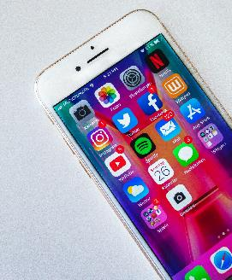
Topic 1: Social Media & Online Communication
Main Objectives:
State what Social Media and online communication is
To introduce learners to online communication using
1. WhatsApp
2. Messenger
Explain how to use social media platforms
1. Facebook
Figure out how to use LinkedIn for job searching and networking
Figure 2: Social Media Source: Unsplash

Slide 9
Topic 1: Social Media & Online Communication
According to Cambridge dictionary (n.d.) Communication is “the process by which messages or information is sent from one place or person to another, or the message itself”.
So what is Online Communication? Any kind of communication between either individuals or organizations that occurs on the internet (IGI Global Dictionary, n.d.).
Social Media is a type of internet-based communication that comes in a variety of forms.
For instance: podcasts, social Book-marking, micro blogging and blogging, social networking…

Slide 10
Topic 1: Social Media & Online Communication
But why is online communication important?
According to Datareportal (n.d.) webpage 5.16 billion people around the world use the internet, this is, the 64.4 percent of the world's total population.
When it comes to the users 92.3 percent use a mobile phone to search online. More precisely, when referring to young people, a fifth of 16 to 21 years old spend more than six hours or more on their smartphones every day.
In addition, the 96% of people aged between 18-29 year old are internet users, 84% use social networking sites, and 97% have mobile phones.

Slide 11


Topic 1: Social Media & Online Communication
What is WhatsApp?
WhatsApp is a free cross-platform messaging service which lets users call and exchange text, photo, audio and video messages with others across the globe for free (Barney, n.d.).
But how do I send photos, attachments, make phone calls or even video calls? Take a look at the video on the left!

Slide 12
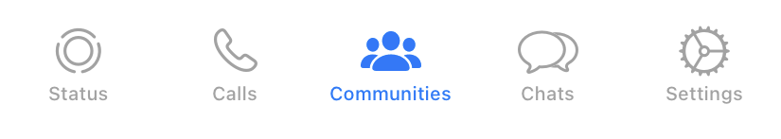
WhatsApp screenshot/buttons
Status - to share text, photo, video, and GIF updates that disappear after 24 hours
Calls - to make video or audio phone calls from WhatsApp
Communities - to organize and bring related groups together under one umbrella
Chats - to share verbal and written information and in addition, share documents and photos
Settings - to set privacy settings: profile picture, read receipts and when you are logged in

Slide 13
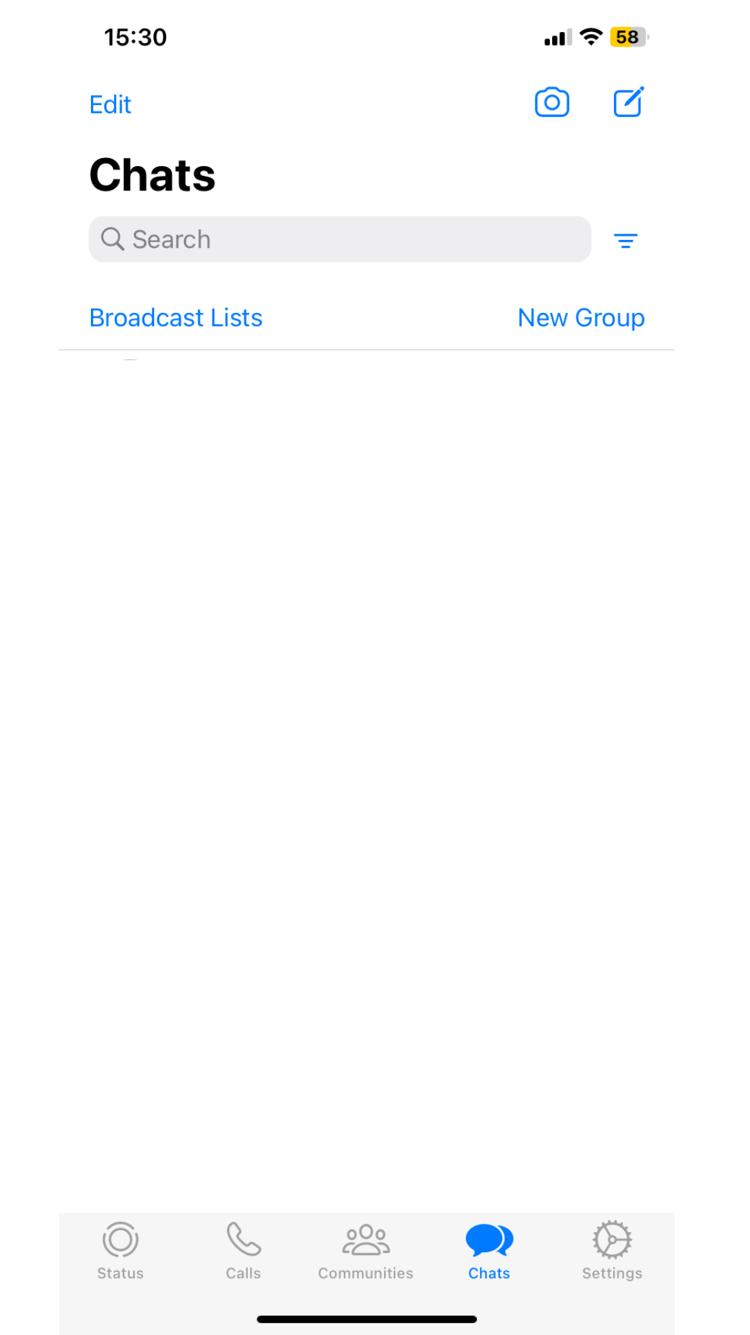
WhatsApp – How to send text messages
2
After the first step, please, click here in order to search for the contact who you will send a message to.
Please, click on the Chats icon to send a message.
1

Slide 14
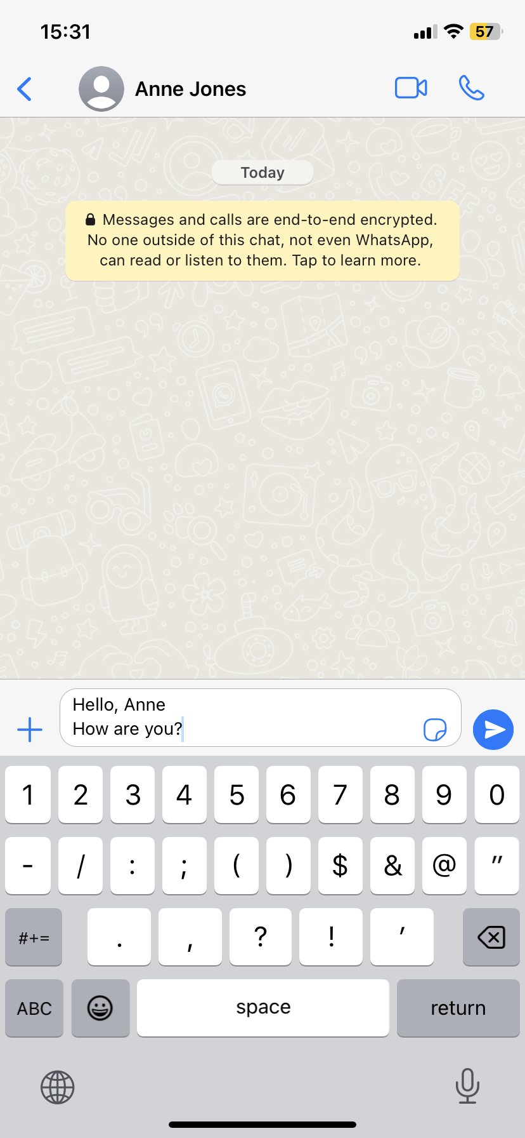
WhatsApp – How to send text messages
3. After choosing who you will write to, please, write the information in the field marked by the arrow.
4. Succeeding, press the blue circular button on the right side of the message you have typed, please.
3
4

Slide 15
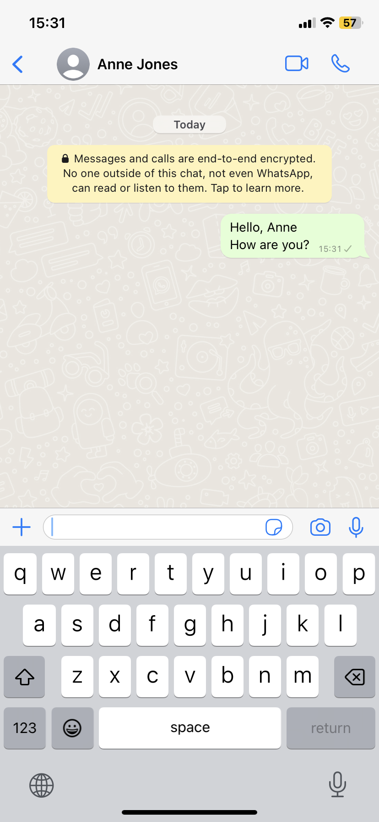
WhatsApp – How to send text messages
5
Once you have completed the above 4 steps, in step 5, you should see how the message you have written has been sent.

Slide 16
WhatsApp – How to send text messages
2
5
3
4
1

Slide 17
WhatsApp – How to send photos, documents, location, contacts or even a poll
To send a photo, as in the following example, please first select the (+) symbol at the top left side of the keyboard.
1

Slide 18
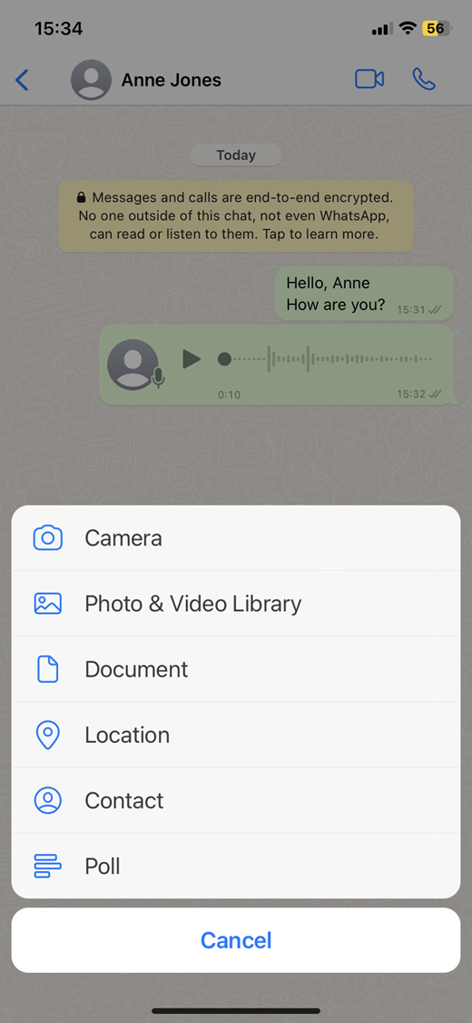
WhatsApp – How to send photos, documents, location, contacts or even a poll
Among the options that will appear, please select the option that reads as follows: Photo & Video Library and select the photo you would like to send from your phone's photo gallery.
2

Slide 19

WhatsApp – How to send photos, documents, location, contacts or even a poll
After you have selected the photo you would like to send, please click on the blue icon at the bottom right to send it.
3

Slide 20
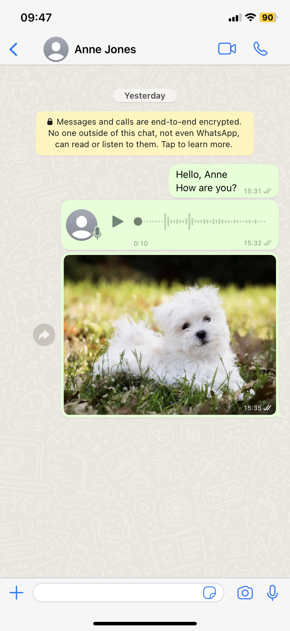
WhatsApp – How to send photos, documents, location, contacts or even a poll
Once you have completed the 4 previous steps, you should be able to see the photo you have selected in the chat, as in the picture below.
4

Slide 21
WhatsApp – How to send photos, documents, location, contacts or even a poll
2
4
1
3

Slide 22
WhatsApp – How to send voice messages
To send an audio message, first of all, please select the microphone symbol at the top right of the keyboard.
1

Slide 23
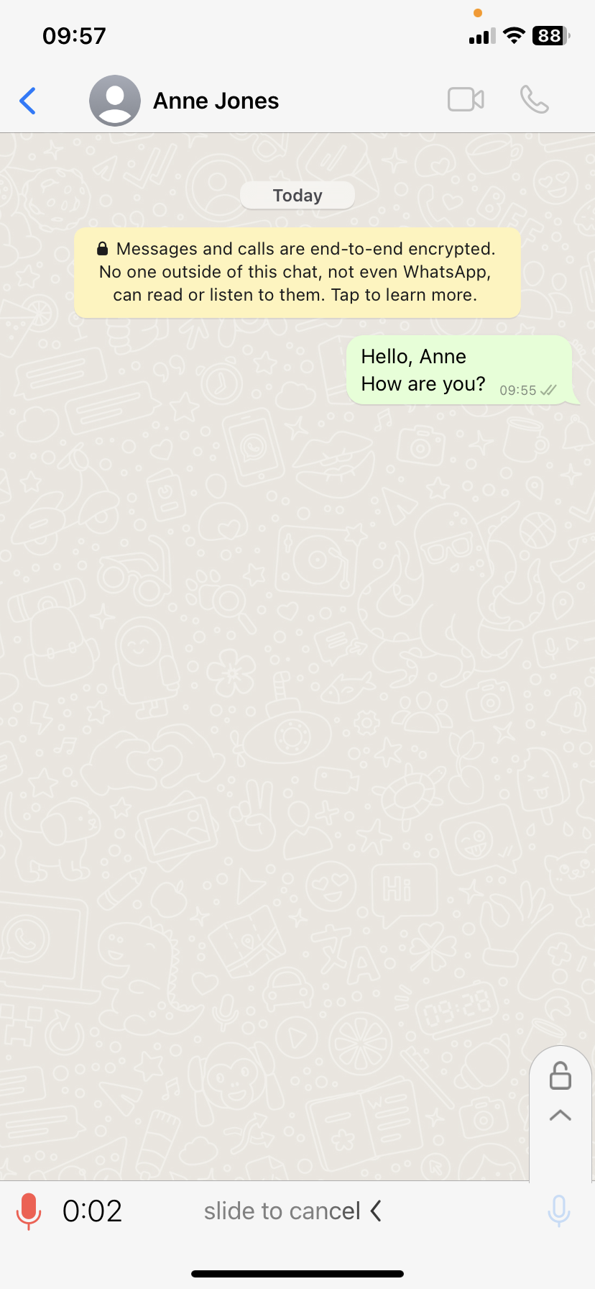
WhatsApp – How to send voice messages
Once you have clicked on the microphone, you will record the audio you want to send to the person you want to send it to.
Please, remember that:
While you are recording the audio, you should not remove your finger from the screen, otherwise the audio will not last as long as you want it to last.
2

Slide 24
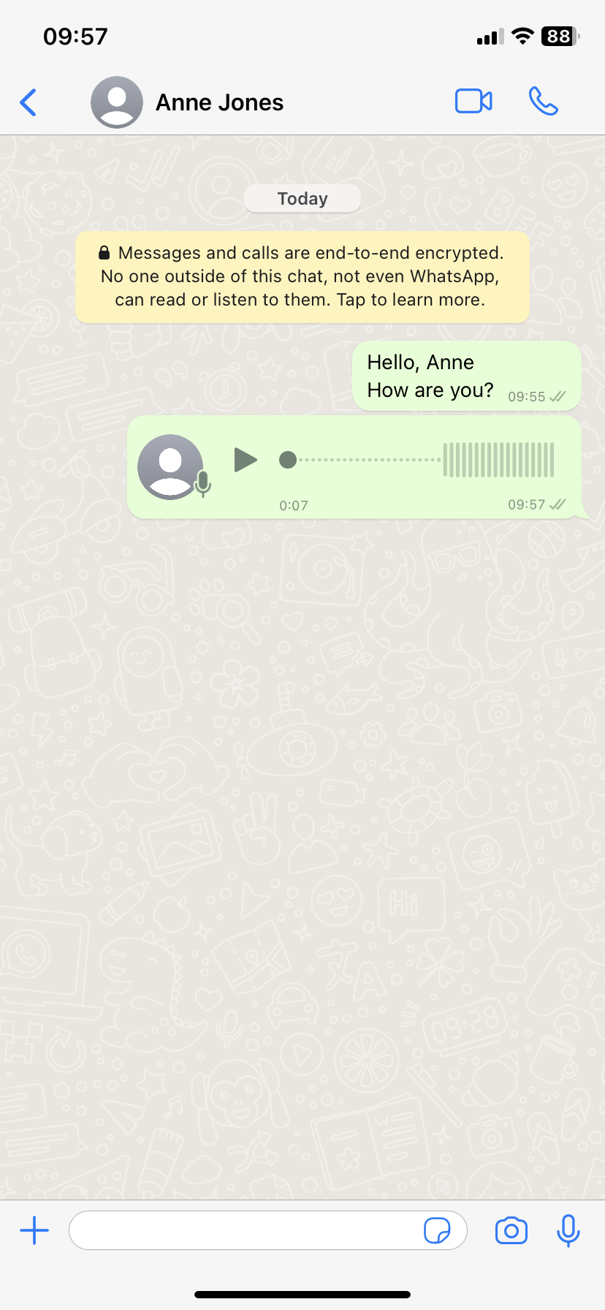
WhatsApp – How to send voice messages
3
When you finish the audio, after lifting your finger from the screen, it will be automatically sent to the chat.

Slide 25
WhatsApp – How to send voice messages
3
1
2

Slide 26
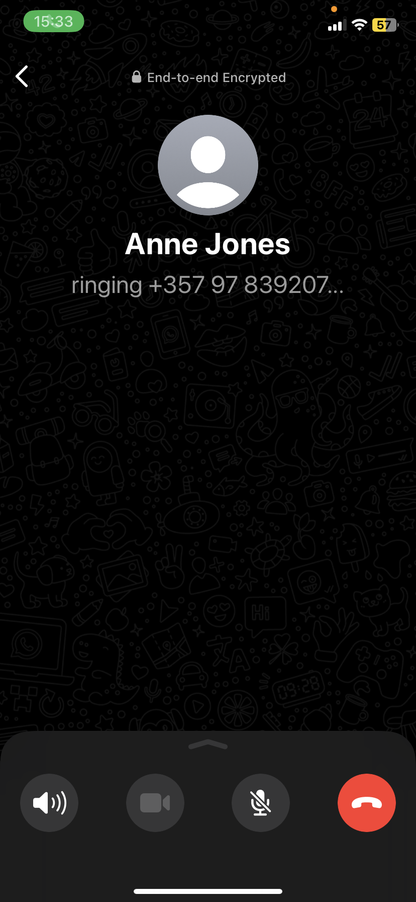
WhatsApp – How to make phone calls
1
To make a phone call through WhatsApp, please first select the chat of the person you want to send it to. Once you have selected the person you want to send an audio message to, click on the phone symbol (at the top right of the screen). Following this, the call will start automatically.
OPTION 1

Slide 27
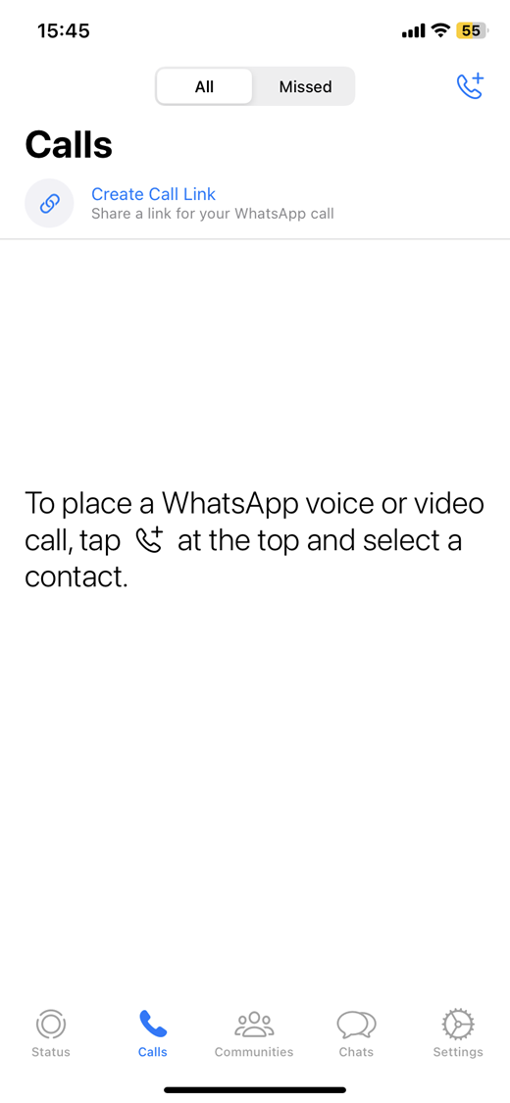
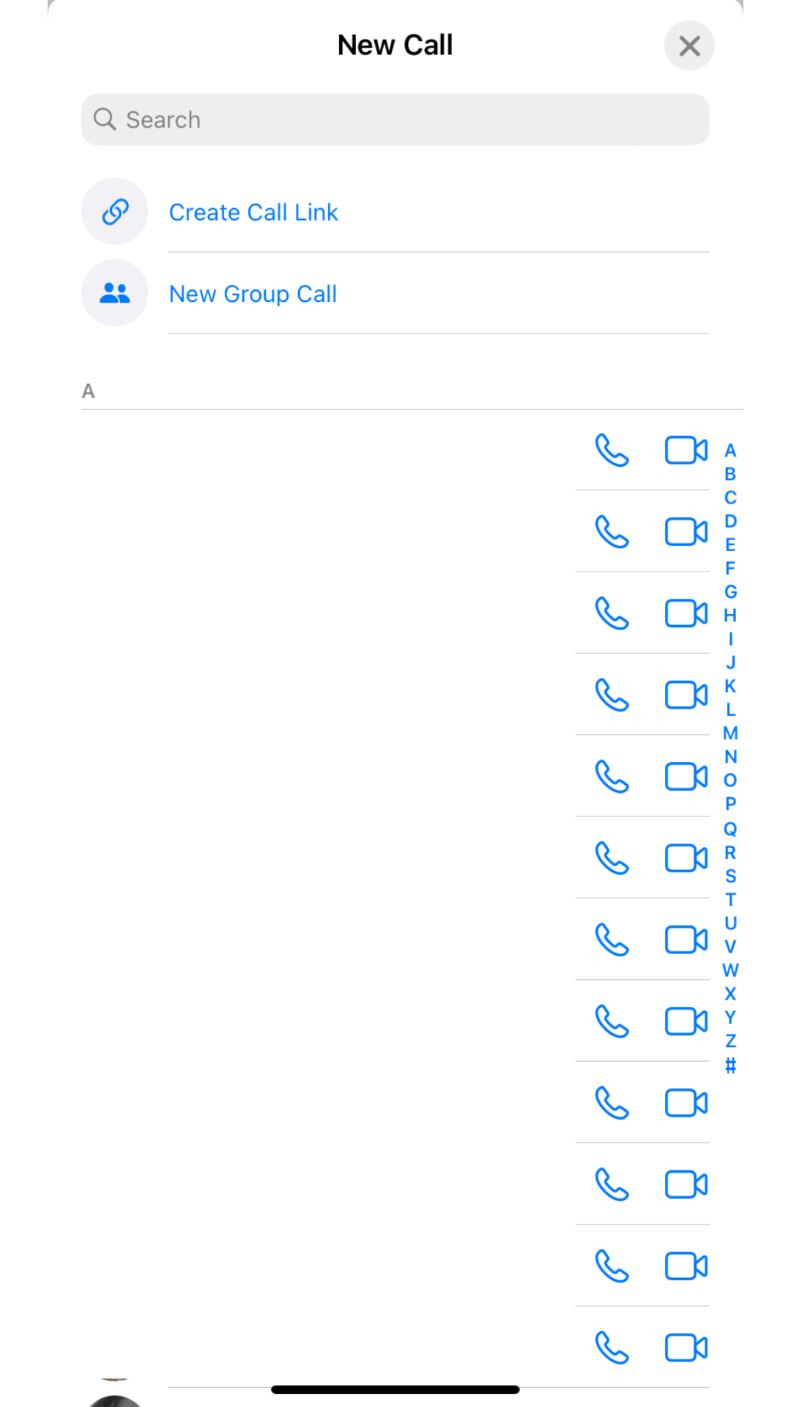
WhatsApp – How to make phone calls
2
To make a phone call through WhatsApp, please first go to the bottom button where it says: Calls. When you are on this screen, please, you will select the phone symbol at the top right of the screen. It will be after this step when you will select from your contacts the person you want to call and that the call will start automatically.
3
1
OPTION 2

Slide 28
WhatsApp – How to make phone calls
1
2
1
OPTION 1
OPTION 2

Slide 29
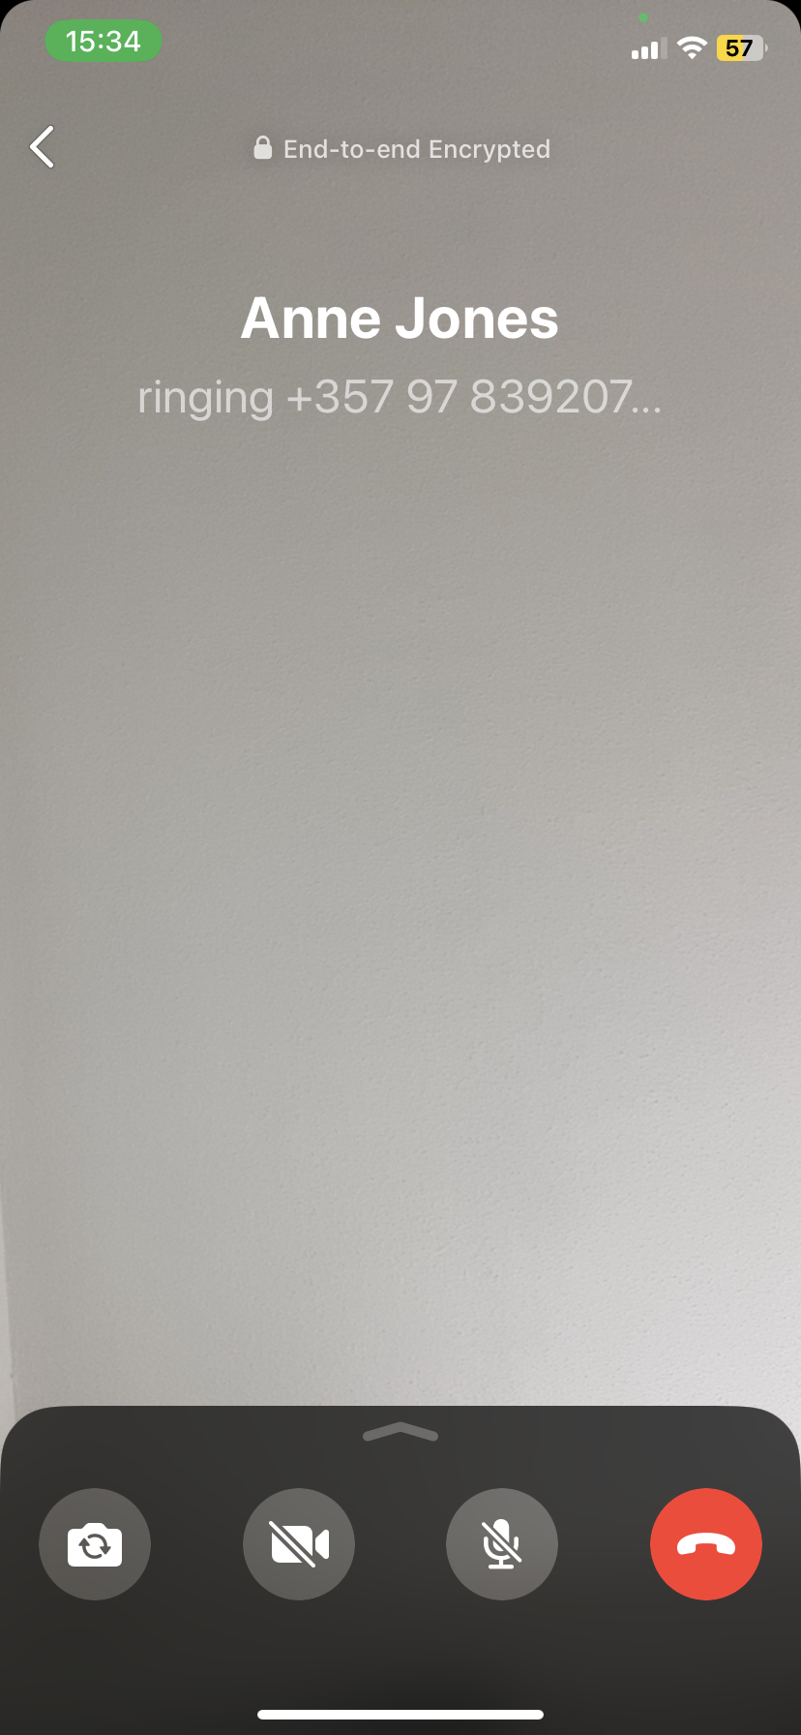
WhatsApp – How to make video calls
1
To make a video call through WhatsApp, please first select the chat of the person you want to send it to. Once you have selected the person you want to make a video call with, click on the camera symbol (at the top right of the screen). Following this, the video call will start automatically.
2

Slide 30


Topic 1: Social Media & Online Communication
What is Messenger?
As mentioned in the Webwise.ie webpage (n.d.) Messenger is a free mobile messaging app by means of which people can send instant messages, share photos, videos, audio recordings and enables the creation of group chats.
However, how can I send messages and attachments? Take a look at the video on the left!

Slide 31
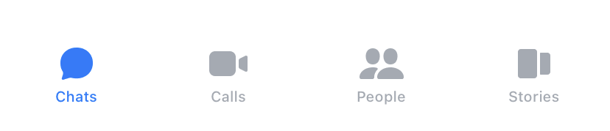
Messenger
Chats - to share verbal and written information and in addition, share documents and photos
Calls - to make video or audio phone calls from Messenger
People - to find your friends wo use Facebook messenger
Stories - to share text, photo, video, and GIF updates that disappear after 24 hours

Slide 32
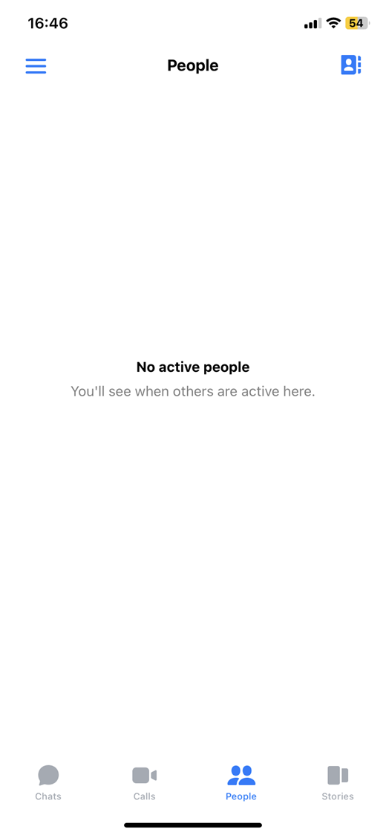
Messenger – How to send text messages
2
After the first step, please, click here in order to search for the contact who you will send a message to.
Please, click on the People icon to send a message.
1

Slide 33
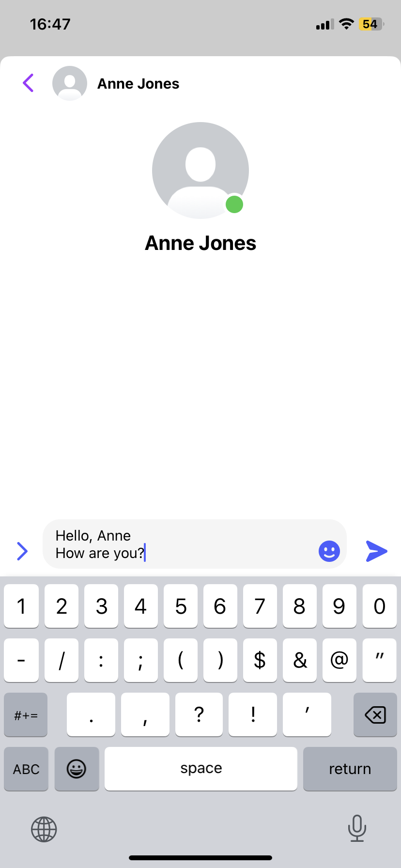
Messenger – How to send text messages
3. After choosing who you will write to, please, write the information in the field marked by the arrow.
4. Succeeding, press the purple plane button on the right side of the message you have typed, please.
3
4

Slide 34
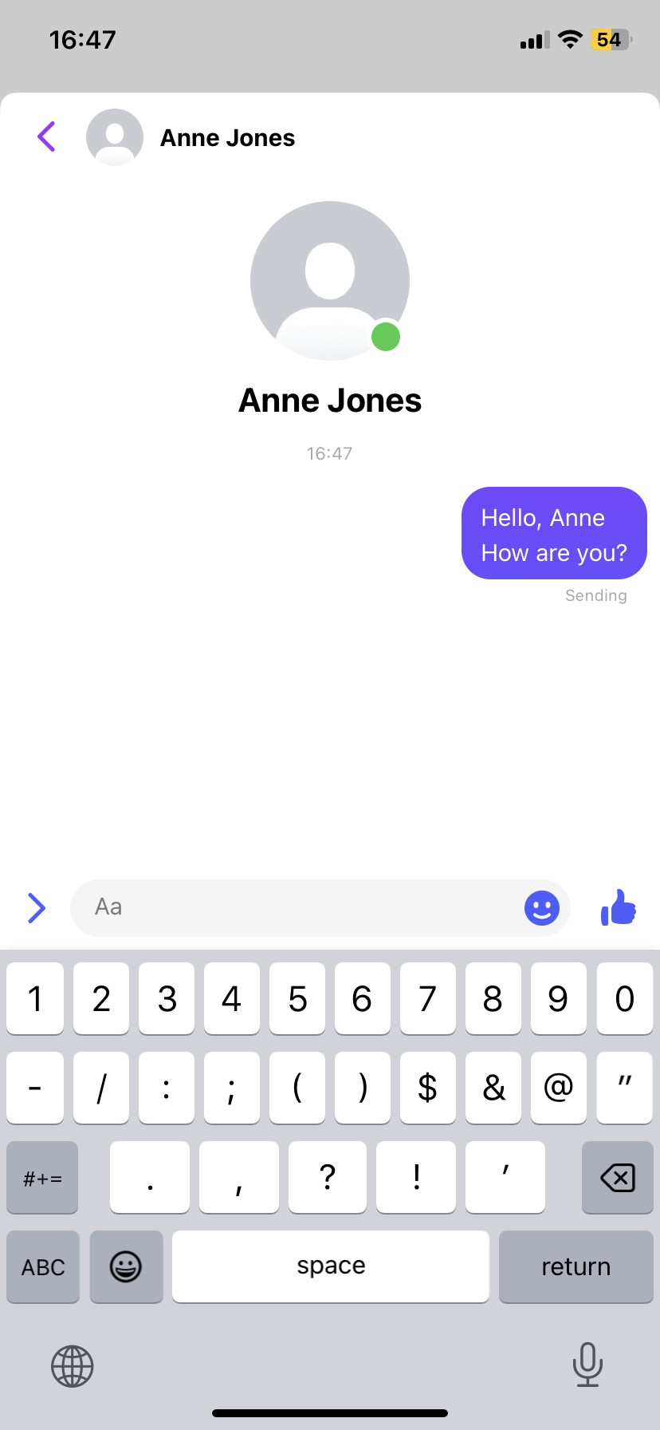
Messenger – How to send text messages
5
Once you have completed the above 4 steps, in step 5, you should see how the message you have written has been sent.

Slide 35
Messenger – How to send text messages
2
5
3
4
1

Slide 36
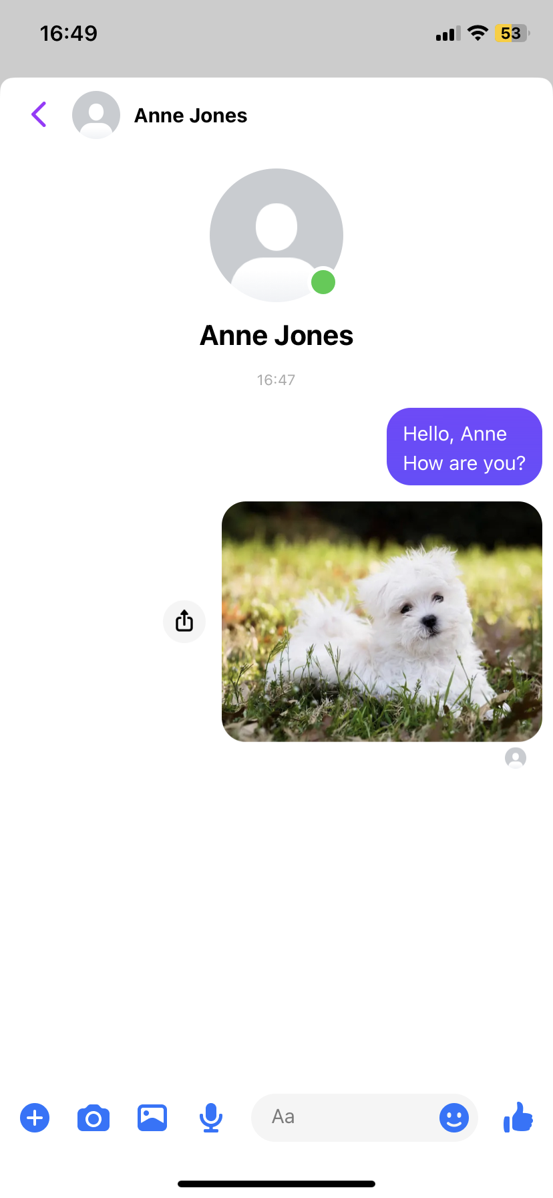
Messenger – How to unsend messages
To delete the message you have sent, please select the message and hold the screen.
1

Slide 37
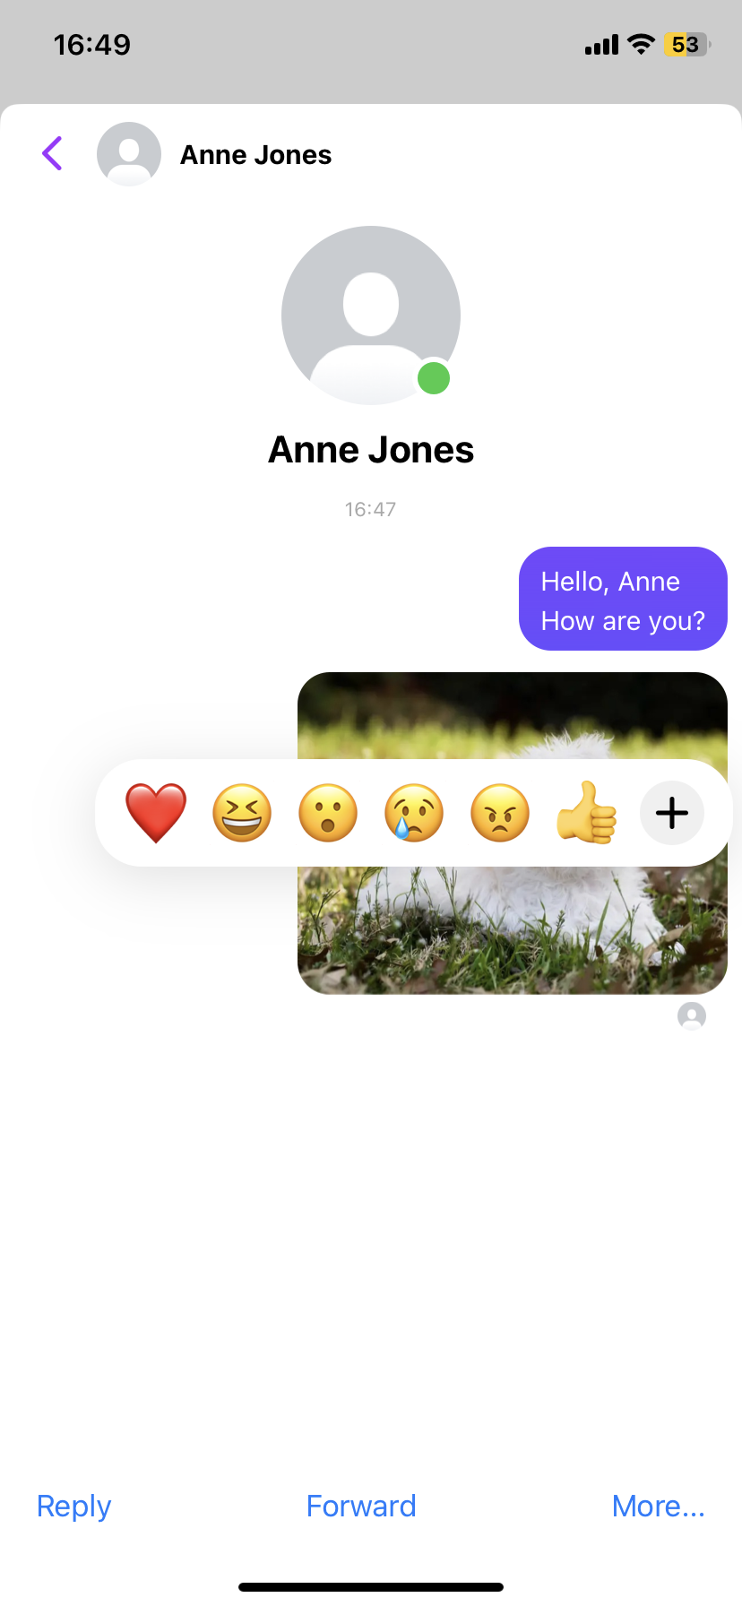
Messenger – How to unsend messages
Once you get several options on the screen you should select the option that says More… in the lower right hand side of the screen, please.
2
3

Slide 38
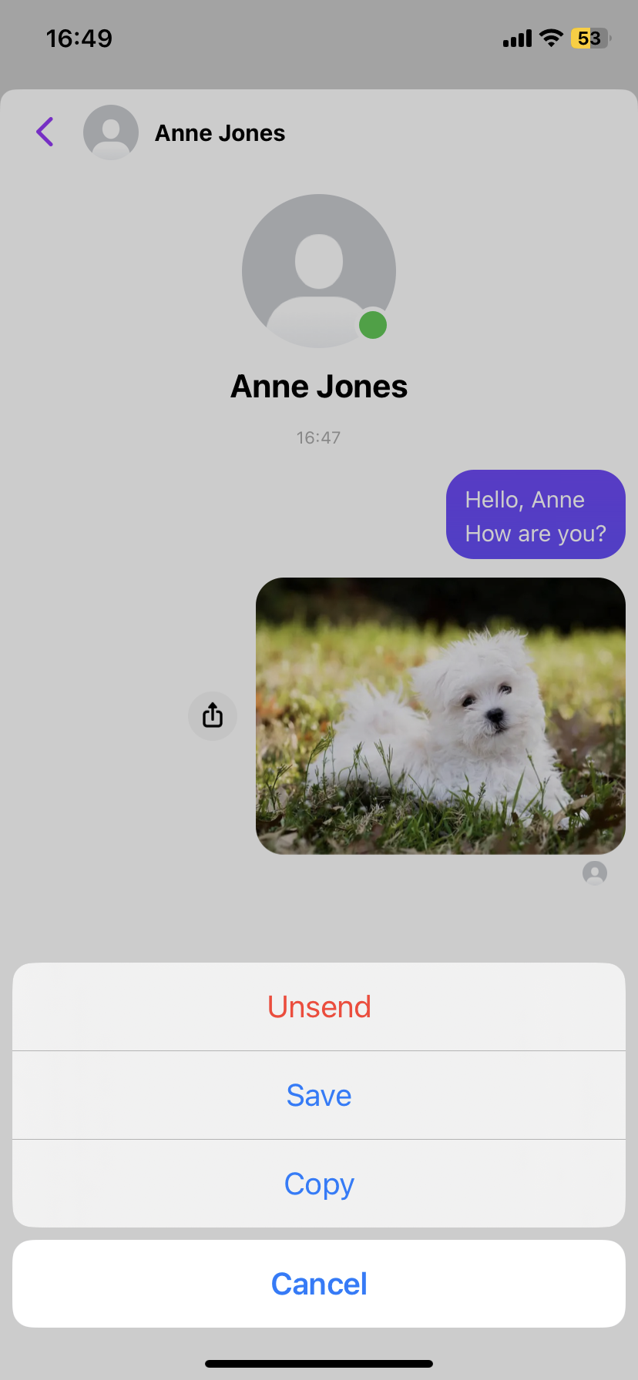
Messenger – How to unsend messages
Following step 3, please select the first option which reads as follows: Unsend.
4

Slide 39
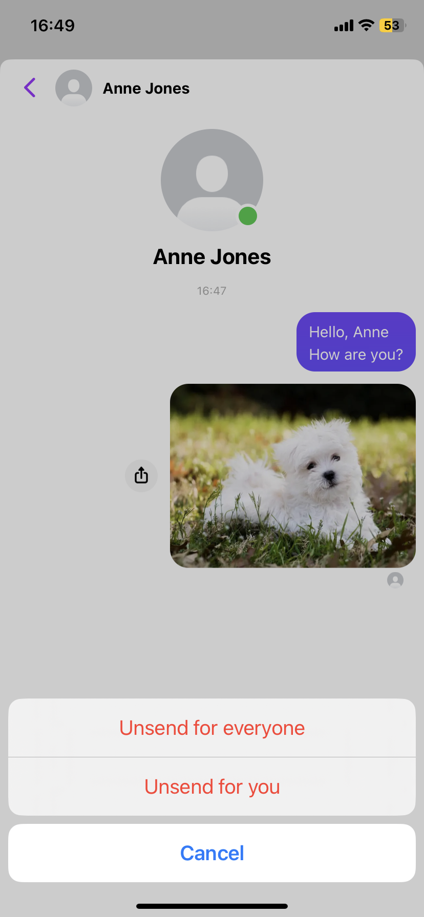
Messenger – How to unsend messages
As shown you will have to select between two options: Unsend for everyone or Unsend for you.
If you select the first option you will delete the message for both the person you were sending it to and for you. While if you select the option that says Unsend for you, the other person will still receive and be able to read the message while for you the message will no longer appear on the screen. Please, make the right choice.
5

Slide 40
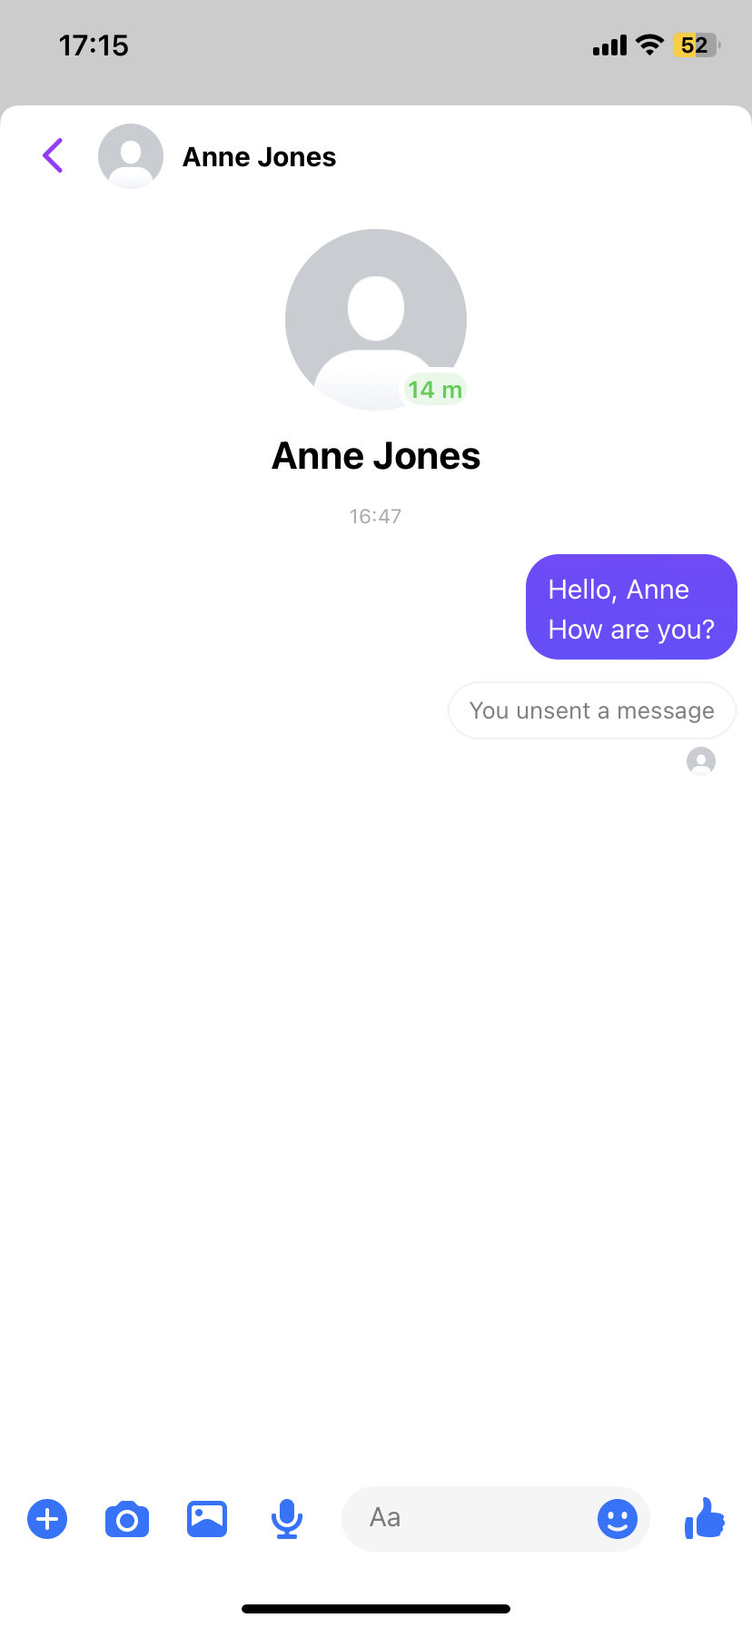
Messenger – How to unsend messages
After having carried out all the previous steps correctly, you should see that the message you have deleted no longer appears on the screen and that now a small window with the following message appears: You unsent a message.
6

Slide 41
Messenger – How to unsend messages
6
2
4
5
1
3

Slide 42
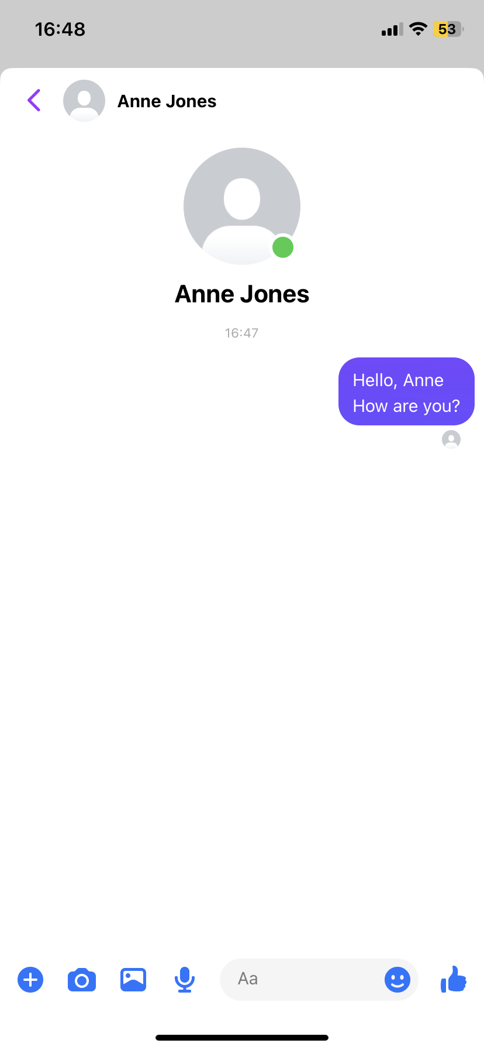
Messenger – How to attach photos
To attach a photo, as in the following example, please first select the picture symbol at the lower right corner.
1

Slide 43
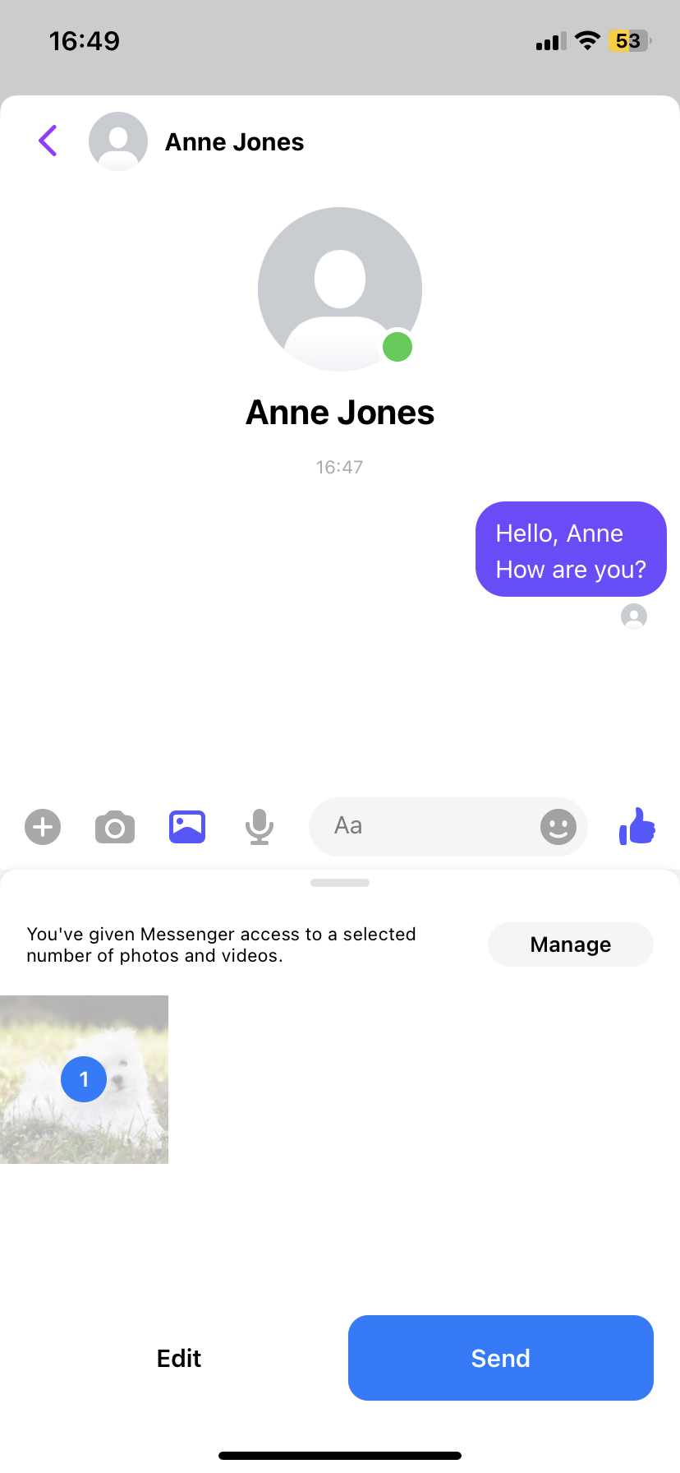
Messenger – How to attach photos
2. Among the photos that will appear, please select the photo you would like to send from your phone's photo gallery.
3. After this, press the blue button on the bottom right part that says send.
2
3

Slide 44
Messenger – How to attach photos
Once you have completed the 3 previous steps, you should be able to see the photo you have selected in the chat, as in the picture.
4

Slide 45
Messenger – How to attach photos
4
2
1
3

Slide 46
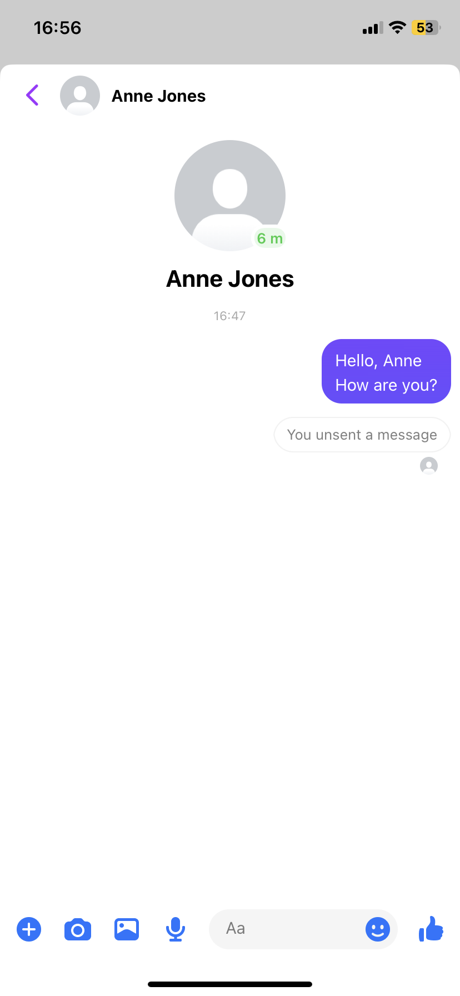
Messenger – How to send voice messages
To send an audio message, first of all, please select the microphone symbol at the bottom lefts side of the screen.
1

Slide 47
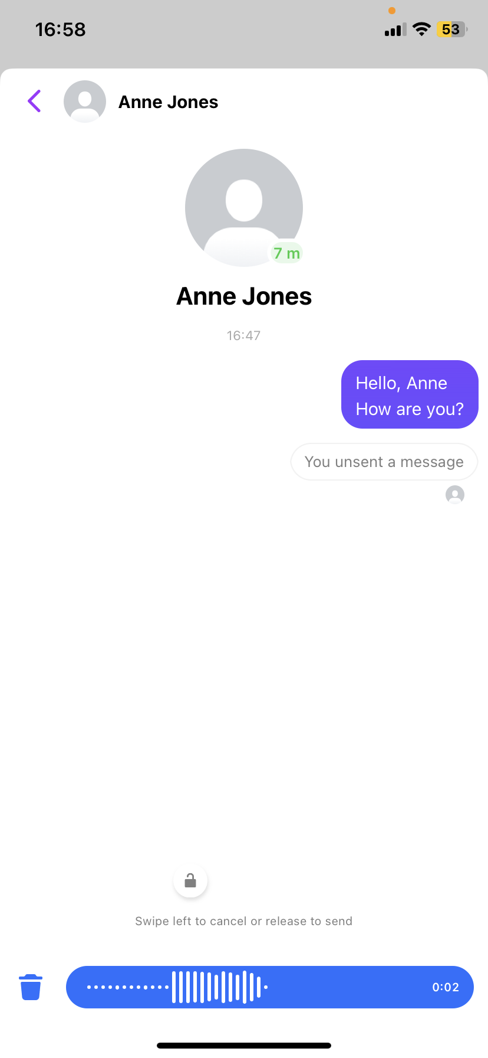
Messenger – How to send voice messages
Once you have clicked on the microphone, you will record the audio you want to send to the person you want to send it to.
Please, remember that:
While you are recording the audio, you should not remove your finger from the screen, otherwise the audio will not last as long as you want it to last.
2

Slide 48
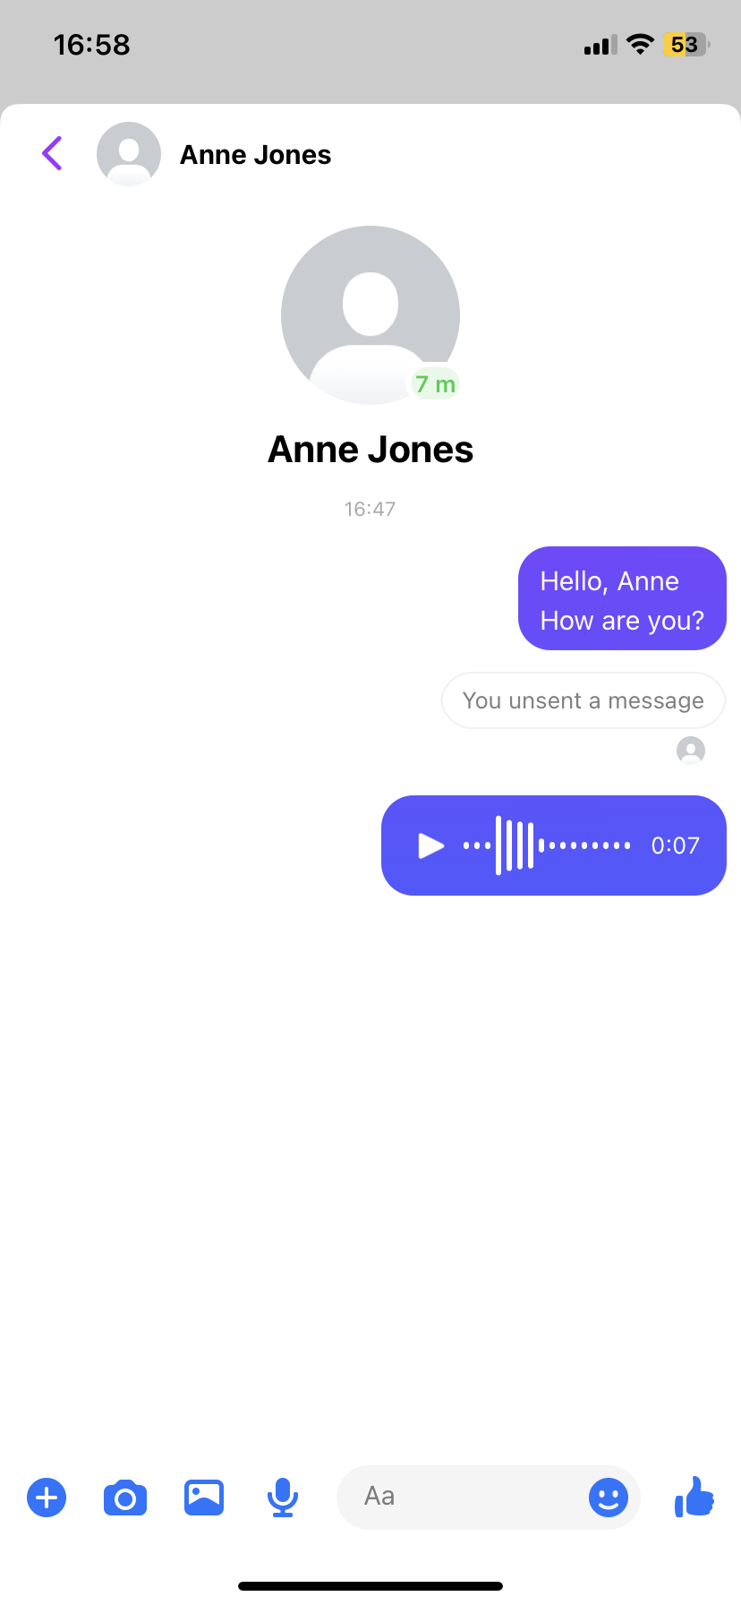
Messenger – How to send voice messages
When you finish the audio, after lifting your finger from the screen, it will be automatically sent to the chat, as in the picture.
3

Slide 49
Messenger – How to send voice messages
3
2
1

Slide 50


Topic 1: Social Media & Online Communication
What is Facebook?
According to GCFGlobal webpage (n.d.) Facebook is “social networking site that makes it easy for you to connect and share with family and friends online”. More precisely, Groups are a place to connect, learn and share with people who have similar interests. You can create or join a group for anything — stargazing, baking, parenting — with people across the globe or across the street. Groups can be public or private (Facebook webpage, n.d.).
So, how can I share content on Facebook? Take a look at the video on the left!

Slide 51
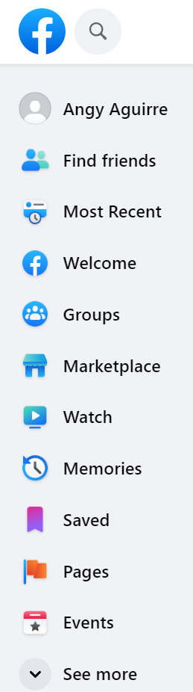
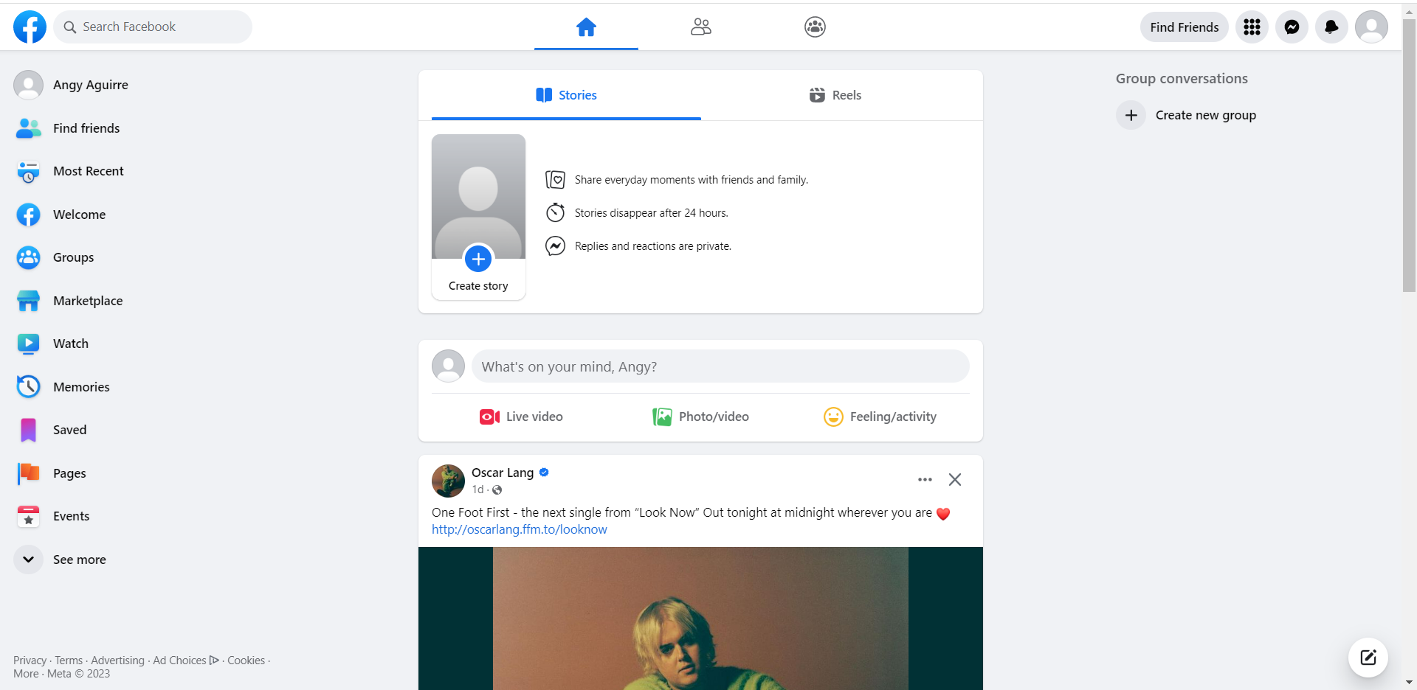
Facebook

Slide 52
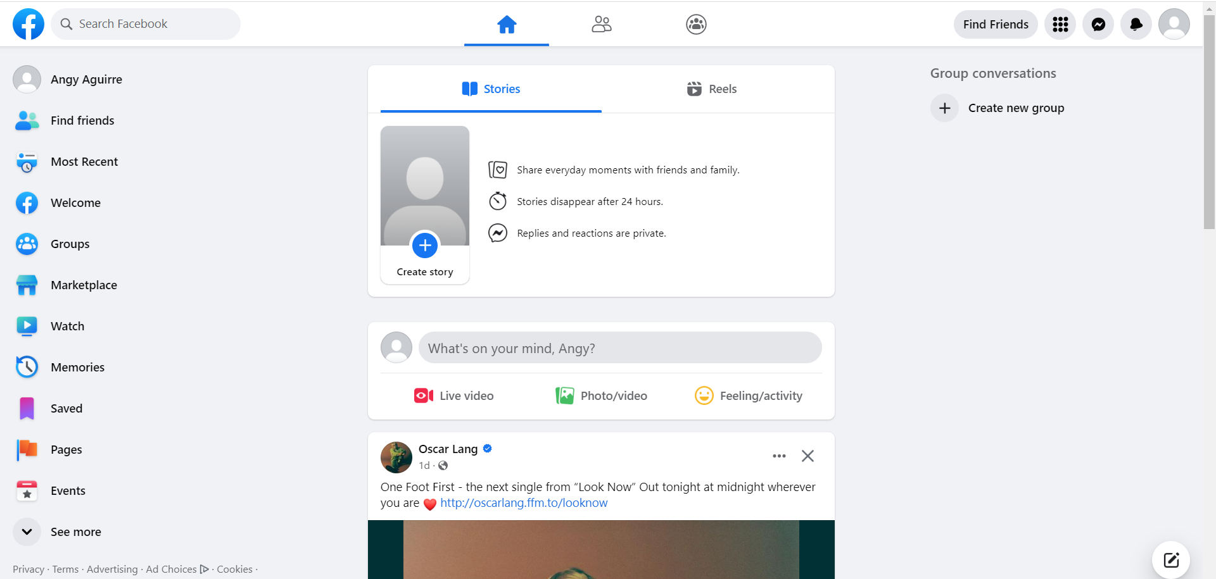

Facebook – How to post content
1

Slide 53
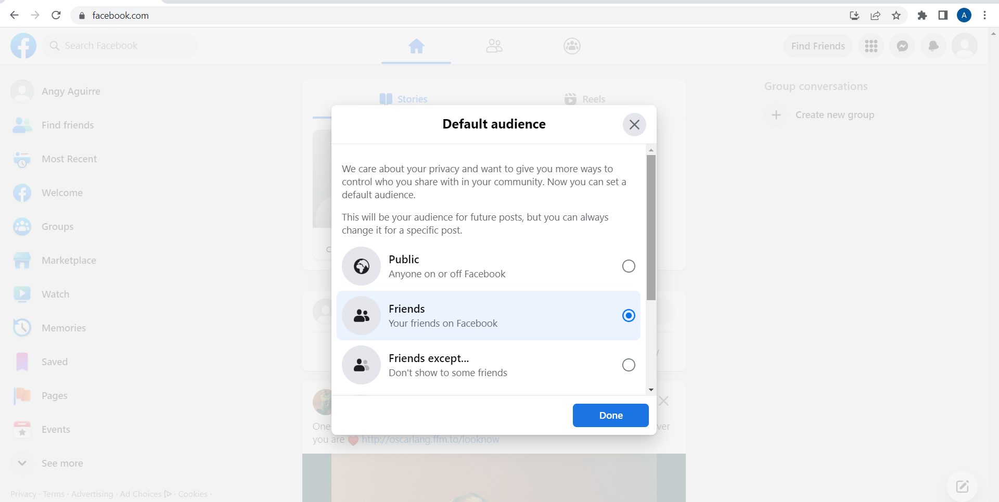
Facebook – How to post content
2

Slide 54
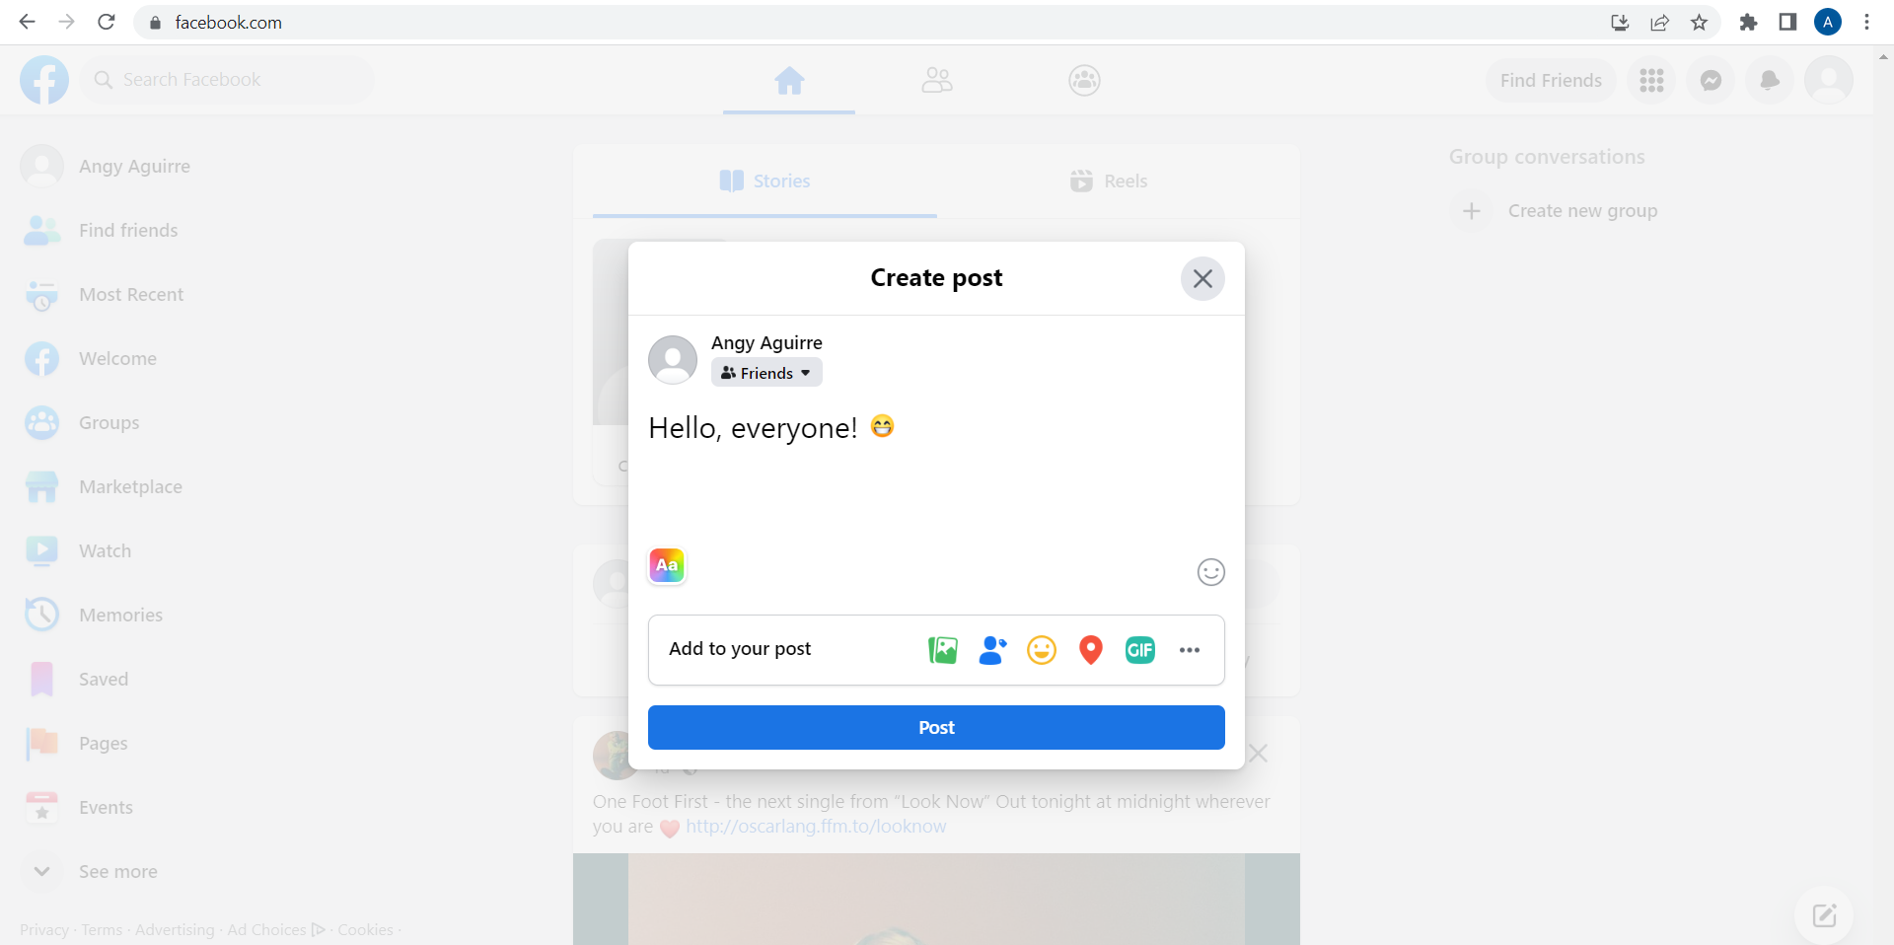
Facebook – How to post content
3
1
2
3

Slide 55

Topic 1: Social Media & Online Communication
What is LinkedIn?
Based on Bouissiere (2021) Linkedin is an employment-oriented social network that facilitates the creation of communities among companies or people with the same interests.
What makes it useful for the labour market?
It's a social network whose main goal is to search for a job and/or share information related to your professional growth and progress.
In 2021 there were almost 771 members registered in the platform.
Facilitates the creation of communities among companies or people with the same interests.

Slide 56


Topic 1: Social Media & Online Communication
How can I use LinkedIn?
See the video below
What steps should I take to find a job?
See the video below

Slide 57
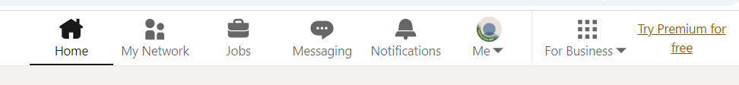
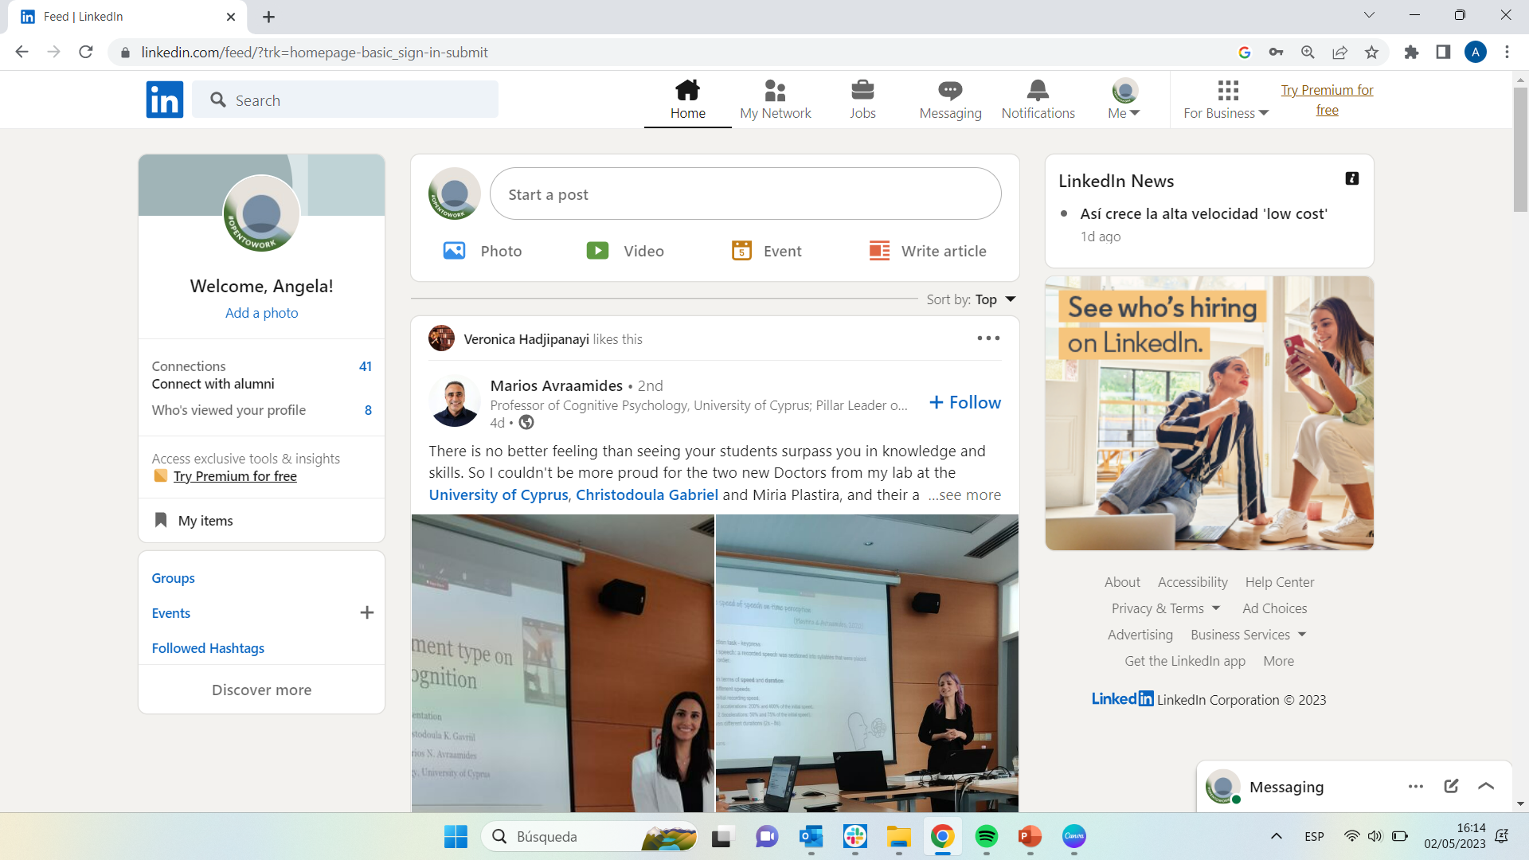
LinkedIn

Slide 58
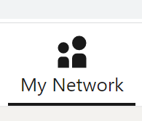
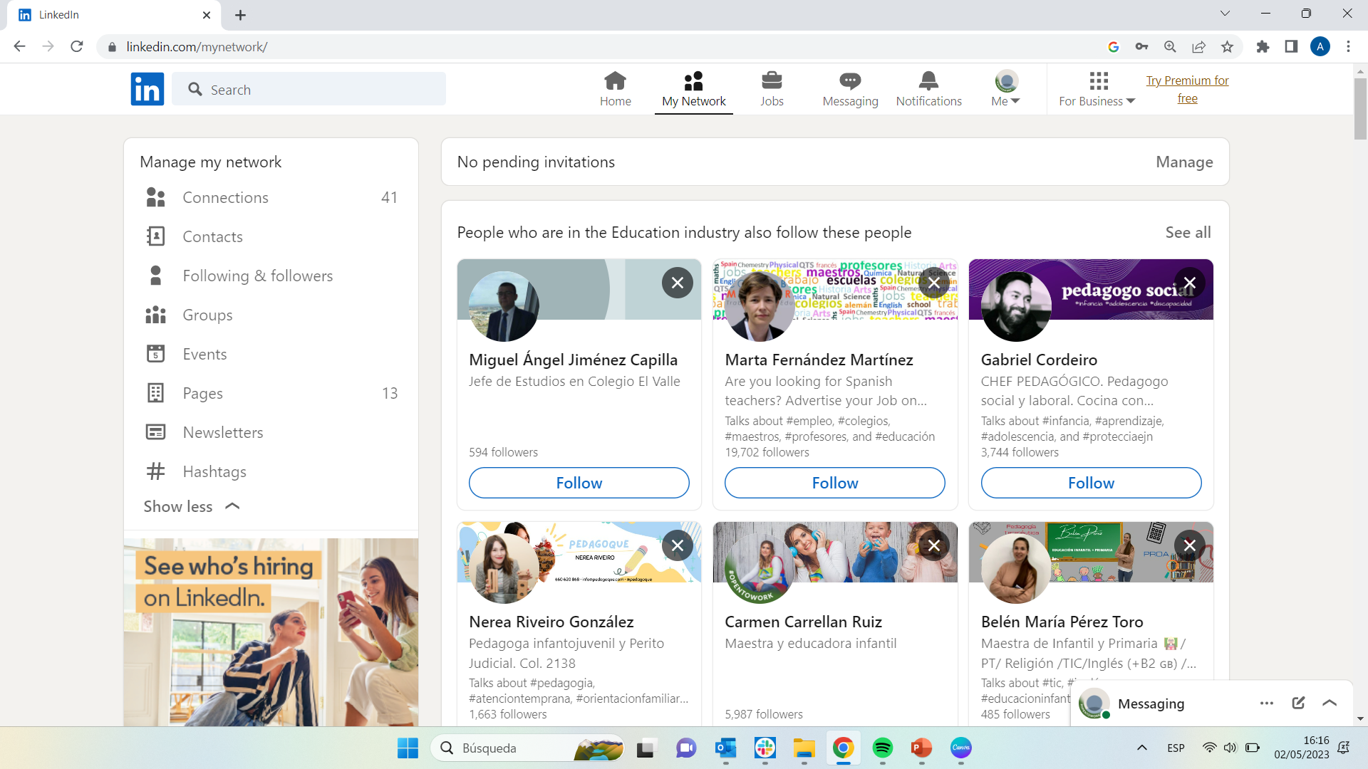
LinkedIn – How to build the LinkedIN network

Slide 59
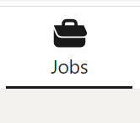
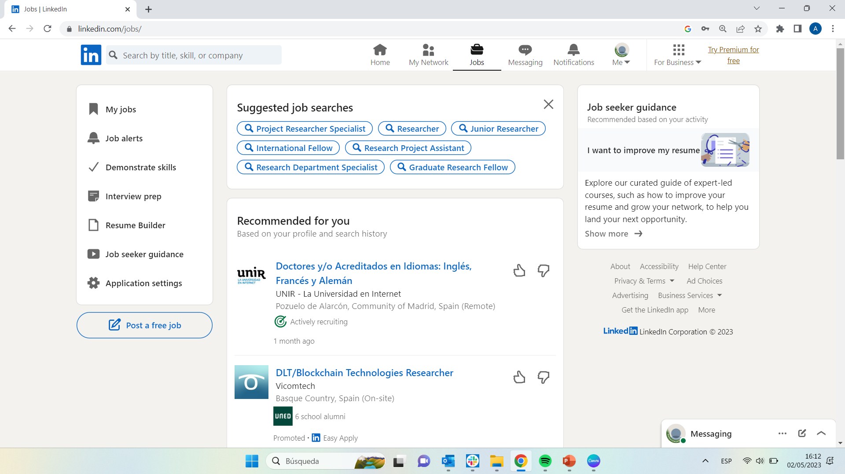
LinkedIn – How to conduct a job search

Slide 60
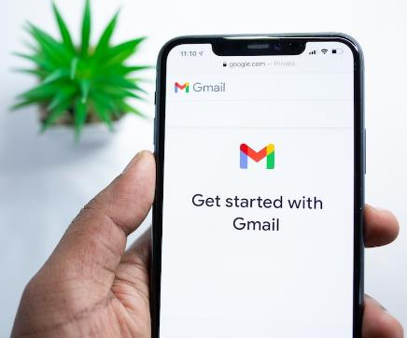
Topic 2: E-mail
Figure 3: Gmail Source: Unsplash
Main Objectives:
State what social e-mail is and it’s importance
Train adults to create an e-mail account using
1. Gmail
Understand how to use e-mail
To be able to
1. Send and receive emails
2. Attach documents

Slide 61


Topic 2: E-mail
What is an E-mail?
According to Indeed webpage (n.d.) an E-mail can be described as “a cost-effective and efficient way to communicate with others using the internet”.
Bearing this in mind, how do I create an account? How can I delete a message? How do I download a document? Check out the video on the left!

Slide 62
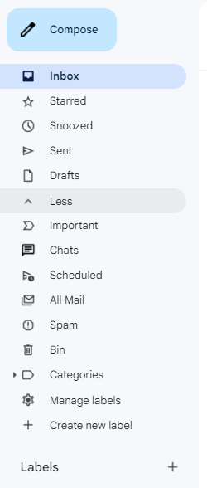
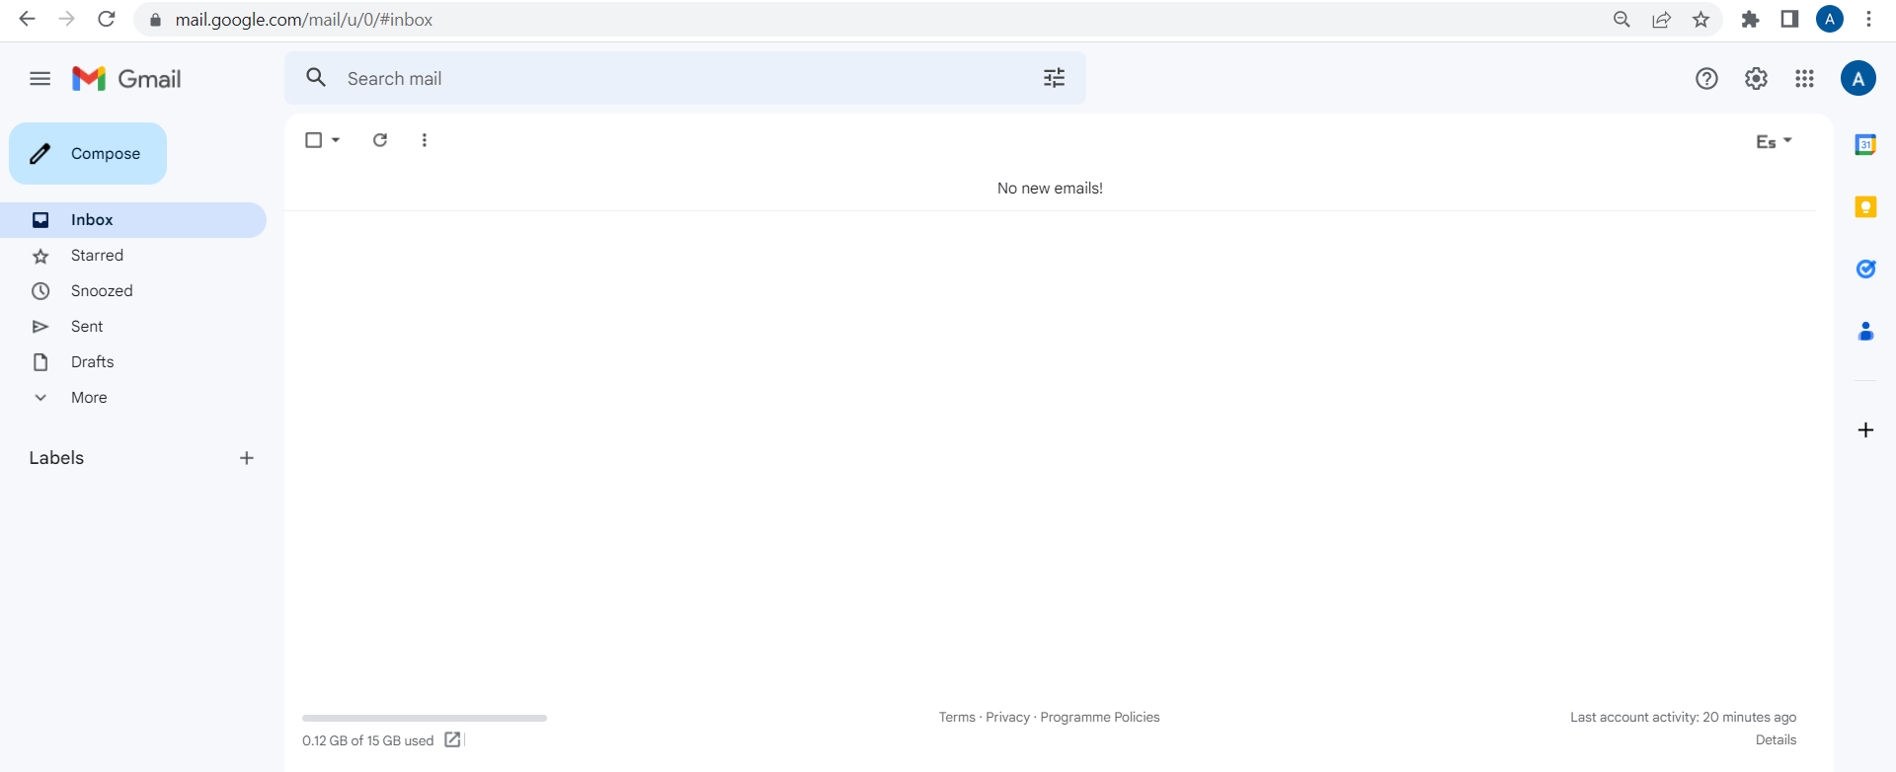
Gmail
This is what a Gmail might look like.
Think of it as space where to receive and send messages/emails.

Slide 63
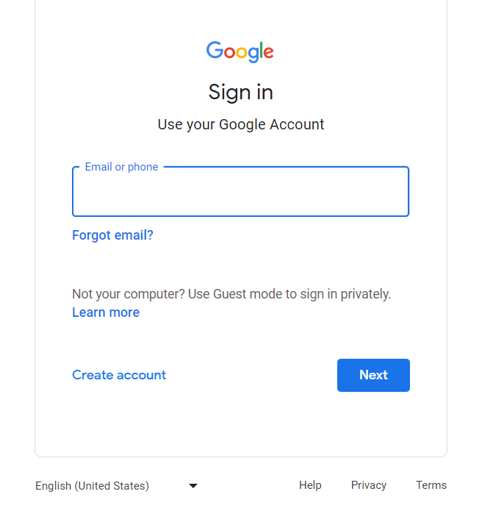
Gmail – How to create an email address
To create a Gmail account the first thing you should do is to open the browser on your computer or mobile phone and type in the following: Gmail.com
Then, after this step, you will see the image on the left where in the center left hand side it says: Create account. Please click on this option.
1

Slide 64
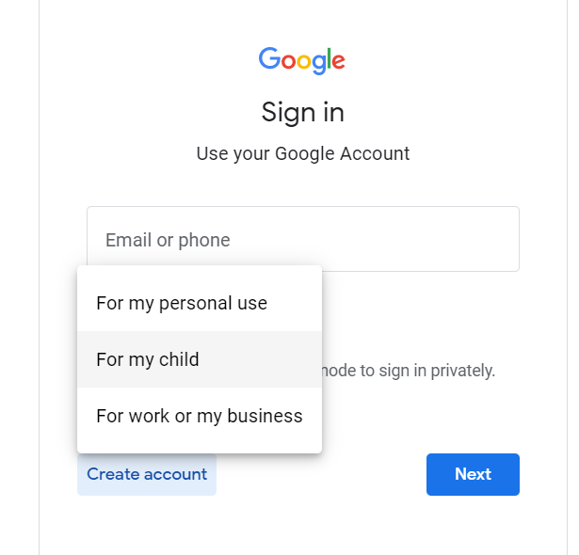
Gmail – How to create an email address
After the first step, you must select the use you want to give to your account. Therefore, please select from the three options that will be displayed on the screen the one that is most suitable for you:
- For my personal use
- For my child
- For work or my business
2

Slide 65
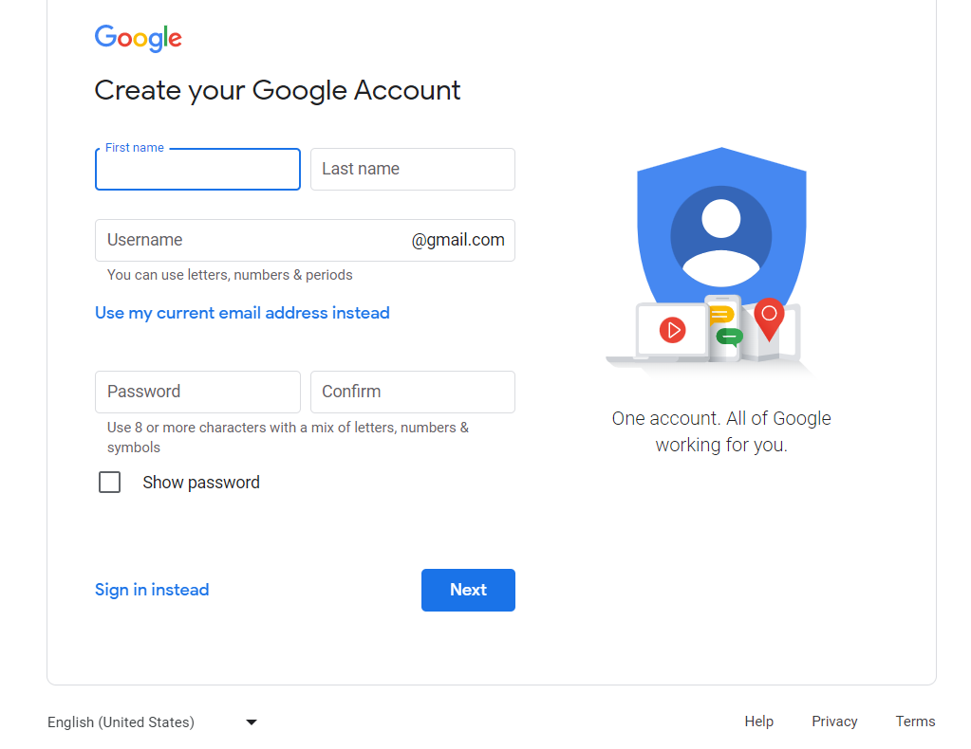
Gmail – How to create an email address
Finally, in step number 3, you must write your First Name, Last Name and the user name you would like to have, for example: AnneJones_67@gmail.com
Please note that when creating an email is recommended to use letters, numbers and periods.
In addition to an email you should also, please, think of a password with which you will access your email. In the case of passwords it is very important to use high security passwords. Here are some suggestions: https://goo.su/5NvYzT
3

Slide 66
Gmail – How to create an email address
2
3
1

Slide 67
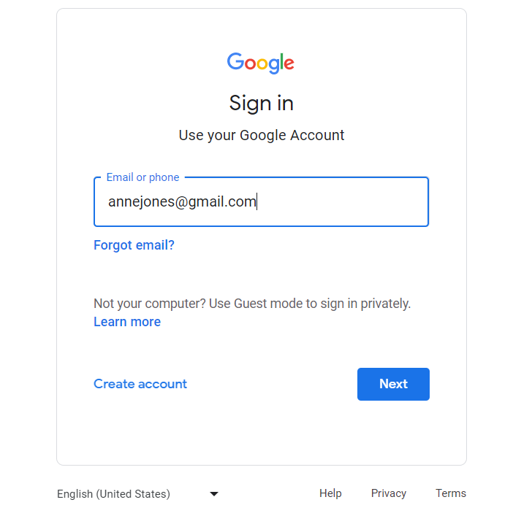
Gmail – How to login
1
Once you have created your own email address and password, it is time to access your Gmail account. To do this you will need to search in the search engine of your computer and/or mobile phone once again for the following: Gmail.com
This is when you will have to insert the email address you have created, please. After this you will select Next at the bottom left of the screen.
2

Slide 68
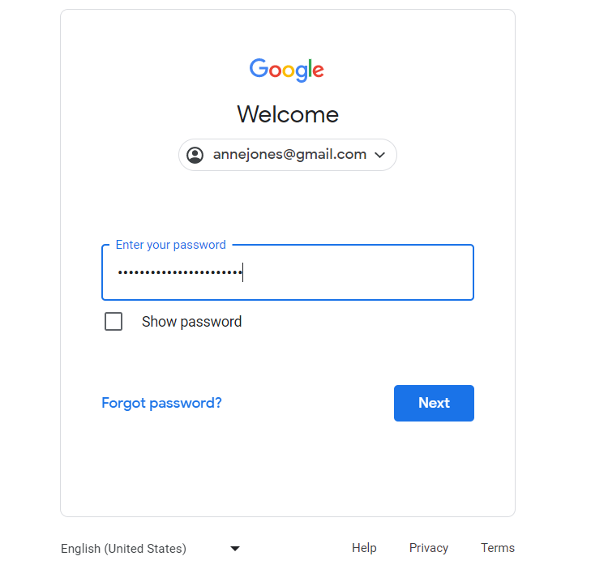
Gmail – How to login
In this second screen, as you have just done in the previous step with the email, you must enter the password that you have considered secure enough and then, select again the button that says: Next, please.
3
4

Slide 69
Gmail – How to login
1
3
2
4

Slide 70
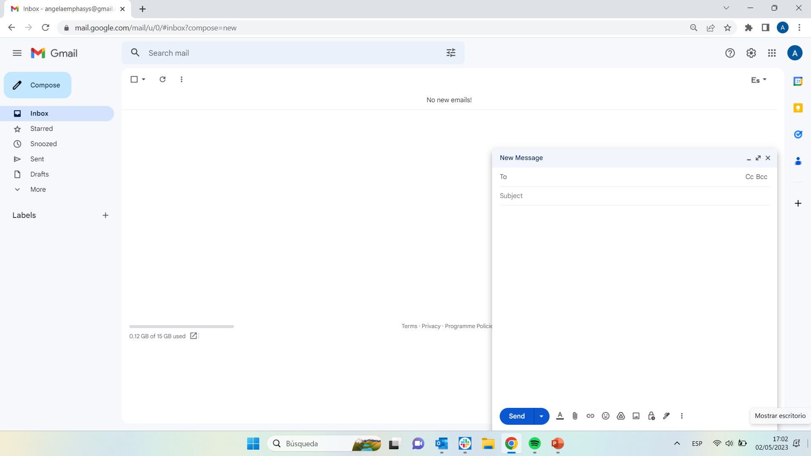
Gmail – How to send an email
As soon as you have logged in to your Gmail account...
1
Click here
2
Click here
3
Click here

Slide 71
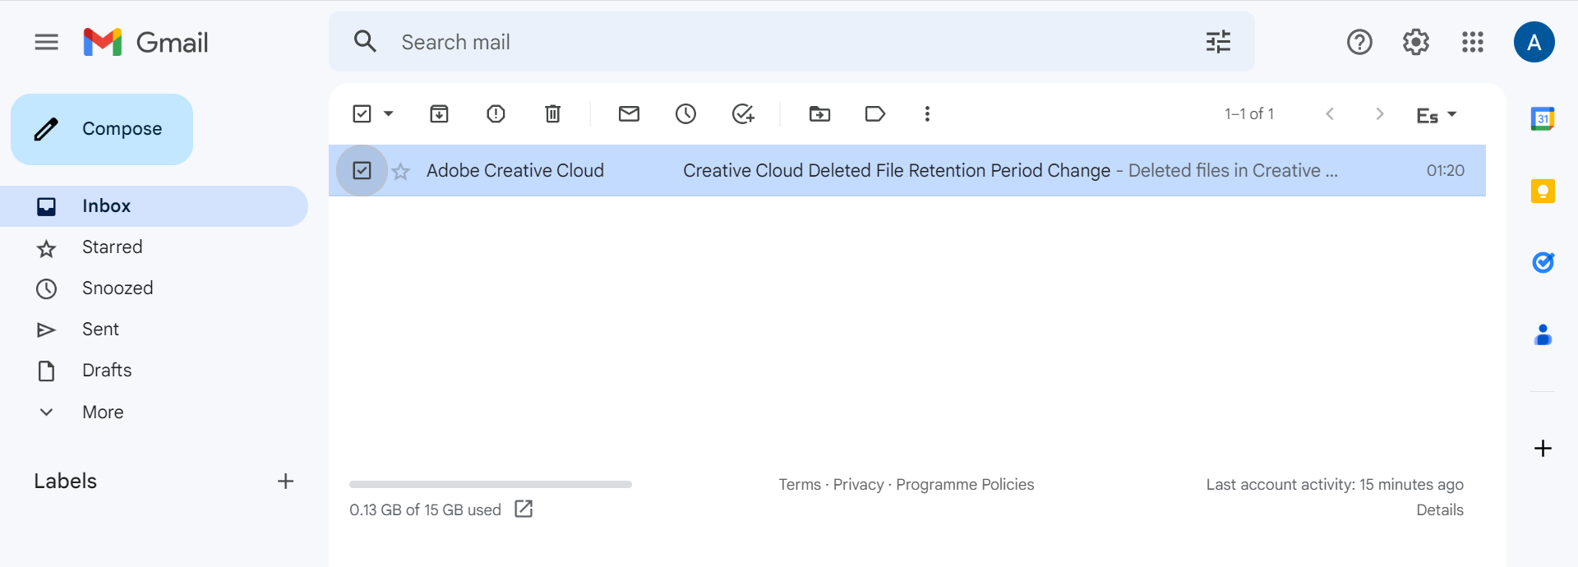

Gmail – How to delete emails
2
1
Click here

Slide 72
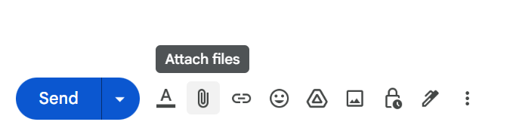
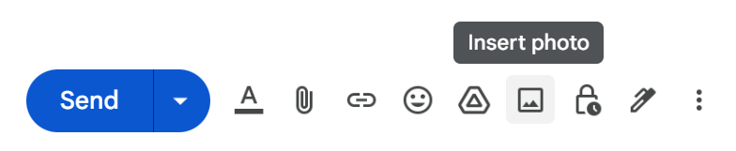


Gmail – How to attach files and photos to an email
Click here
Click here

Slide 73


Gmail – How to download attachments (photos)
Click here

Slide 74


Gmail – How to download attachments (documents)
Click here

Slide 75

Topic 3: Google Drive
Figure 4: My G suite Source: Unsplash
Main Objectives:
Understand what “Online file storage” and “Google Drive” is
Comprehend the main features of
1. Google Drive
2. Google Docs
– Word processing
3. Google Sheets
-Spreadsheet
4. Google Slides
-Presentation
5. Google Forms
- Evaluation form
-Survey/questionnaire

Slide 76


Topic 3: Google Drive
Topic 3: Google Drive
What is Google Drive? Why is it important?
As maintained by Mixon (2018) Google Drive is “a free cloud-based storage service that enables users to store and access files online and which in addition, allows to share the documents with other users. The service syncs stored documents, photos and more across all of the user's devices, including mobile devices, tablets and PCs. Besides, Google Drive is further complemented by Google Docs, Google Sheets, Google Slides and Google Forms.
Ready to make the most of it? Take a look at the video on the left!

Slide 77


Google Drive
This is what a Google Drive might look like.
Think of it as a big storage space for all your documents, forms etc...

Slide 78


Topic 3: Google Drive
Topic 3: Google Drive
What is ‘Google Docs’?
As stated in the BIT.AI Blog webpage (2020) Google Docs is a word processor by Google that operates in the cloud.
Ready to make the most of it? Take a look at the video on the left!

Slide 79

Google Docs

Slide 80

Google Docs – How to create a document
Click here
1
2
Click here

Slide 81

Google Docs – How to create a document
3

Slide 82


Google Docs – How to share a document
Click here
1
2
Click here

Slide 83


Topic 3: Google Drive
Topic 3: Google Drive
What is ‘Google Sheets’?
According to the CFI Team (2022) Google Sheets is a “free, web-based spreadsheet application that is provided by Google within the Google Drive service. The application is also available as a desktop application on ChromeOS, and as a mobile app on Android, Windows and iOS”.
Ready to make the most of it? Take a look at the video on the left!

Slide 84

Google Sheet

Slide 85

Google Sheet – How to create a spreadsheet
1
2
Click here

Slide 86

Google Sheet – How to create a spreadsheet
3

Slide 87


Topic 3: Google Drive
Topic 3: Google Drive
What is ‘Google Slides’?
As maintained by Compute Hop (2021), Google Slides is a free presentation web application that offers the benefits of a cloud storage.
Ready to make the most of it? Take a look at the video on the left!

Slide 88

Google Slides

Slide 89

Google Slides – How to create a presentation
Click here
1
2
Click here

Slide 90

Google Slides – How to create a presentation
3

Slide 91


Topic 3: Google Drive
Topic 3: Google Drive
What is ‘Google Forms’?
Google Forms is a versatile tool that can be used for various applications, from gathering RSVPs for an event to creating a pop quiz by means of creating surveys and quizzes (Business Insider webpage, 2021).
Ready to make the most of it? Take a look at the video on the left!

Slide 92

Google Forms

Slide 93
Google Forms – How to create a form
Click here
1
2
Click here

Slide 94

Google Forms – How to create a form
3

Slide 95

Google Forms – How to share a form
2
Click here
1

Slide 96

Conclusion
In conclusion, online communication with companies and people plays a big role in our daily lives. That is why we must know what the latest advances in social media are in order to be able to make the best use of them. Having the ability to use applications such as LinkedIn, Facebook, Gmail and Google Slides, among many others, is what makes the difference when looking for a job or being hired.
Figure 5: Communication Source: Unsplash
Notes:
Title:
Font: Gadugi
Size: 24
Main body:
Font: Arial Narrow
Size: 20

Slide 97
Bibliography
Barney, N. (2022, September 8). WhatsApp. Mobile Computing. https://www.techtarget.com/searchmobilecomputing/definition/WhatsApp
Bouissiere, Y. (2021, November 3). Cifras clave de LinkedIn 2021 (2020). Proinfluent. https://www.proinfluent.com/es/cifras-clave-linkedin/#:~:text=probarlo%20por%20ratios%20%E2%80%A6-,%C2%BFCu%C3%A1ntos%20usuarios%20hay%20en%20LinkedIn%3F,activos%20mensuales%20en%202019%20%5B2%5D
Communication. (2023). https://dictionary.cambridge.org/dictionary/english/communication
Demarest, A. A. (2022, August 23). What are Google Forms? Everything you need to know about Google Workspace’s online form builder. Business Insider. https://www.businessinsider.com/guides/tech/what-is-google-forms
Digital Around the World — DataReportal – Global Digital Insights. (n.d.). DataReportal – Global Digital Insights. https://datareportal.com/global-digital-overview
Facebook: What is Facebook? (n.d.). GCFGlobal.org. https://edu.gcfglobal.org/en/facebook101/what-is-facebook/1/#
Google Slides. (2021, August 16). https://www.computerhope.com/jargon/g/google-slides.htm
HelpCloud. (2020, December 9). How to Create a Gmail (Google) Account and Basic Gmail Settings Overview [Video]. YouTube. https://www.youtube.com/watch?v=1aUTqoiECJE
Notes:
Title:
Font: Gadugi
Size: 24
Main body:
Font: Arial Narrow
Size: 20

Slide 98
Bibliography
Howfinity. (2020a, May 26). How to Use Google Docs - Beginner’s Guide [Video]. YouTube. https://www.youtube.com/watch?v=z9i_h-WMQ68
Howfinity. (2020b, June 16). How to Use Google Slides - Beginner’s Guide [Video]. YouTube. https://www.youtube.com/watch?v=QHfbShPbtXI
Howfinity. (2020, September 2). How to Use Facebook - Complete Beginner’s Guide [Video]. YouTube. https://www.youtube.com/watch?v=xu8rh9Ref4Y
Howfinity. (2021, February 22). How to Use Facebook Messenger - Beginner’s Tutorial [Video]. YouTube. https://www.youtube.com/watch?v=By2dZw3eYwU
Indeed Editorial Team. (2023, February 24). A Definitive Guide to Email: Importance, Uses and Advantages. Indeed Career Guide. https://www.indeed.com/career-advice/career-development/importance-of-email#:~:text=Email%20is%20important%20for%20communication,multimedia%2C%20like%20photos%20and%20videos
Jordan Platten. (2021, February 1). How to Use LinkedIn 2023 - LinkedIn Tutorial for Beginners (Profile Tips) [Video]. YouTube. https://www.youtube.com/watch?v=3FnovWnhObs
Kevin Stratvert. (2020, May 28). How to use WhatsApp [Video]. YouTube. https://www.youtube.com/watch?v=KgNliKyVY2Q
Staff, D. D. (2019, July 31). 21% of young people spend six hours or more on their phone daily. Irish Examiner. https://www.irishexaminer.com/news/arid-30940600.html
Notes:
Title:
Font: Gadugi
Size: 24
Main body:
Font: Arial Narrow
Size: 20

Slide 99
Bibliography
Kevin Stratvert. (2020b, December 2). How to use Google Drive - Tutorial for Beginners [Video]. YouTube. https://www.youtube.com/watch?v=gdrxAoqfvbA
Kevin Stratvert. (2021, March 18). Google Forms Tutorial [Video]. YouTube. https://www.youtube.com/watch?v=I4T-FGZo7zo
Kevin Stratvert. (2022, November 14). How to use Google Sheets - Tutorial for Beginners [Video]. YouTube. https://www.youtube.com/watch?v=TENAbUa-R-w
McGarrigle, J. (2018, August 8). What is Messenger. Webwise.ie. https://www.webwise.ie/parents/explained-what-is-messenger/
Mixon, E., & Wigmore, I. (2018, March 12). Google Drive. Mobile Computing. https://www.techtarget.com/searchmobilecomputing/definition/Google-Drive
Professor Heather Austin. (2018, April 25). LinkedIn Job Search Tutorial - How To Use LinkedIn To Find A Job [Video]. YouTube. https://www.youtube.com/watch?v=Ox_ohqsIMAM
Trinidad, C. (2022, December 14). Google Sheets. Corporate Finance Institute. https://corporatefinanceinstitute.com/resources/excel/google-sheets/
What is Google Docs And How To Use It. (2021, April 7). Bit Blog. https://blog.bit.ai/google-docs/
What is Online Communication | IGI Global. (n.d.). https://www.igi-global.com/dictionary/online-communication/41155
Notes:
Title:
Font: Gadugi
Size: 24
Main body:
Font: Arial Narrow
Size: 20

Slide 100
Inclusive digital competence training for labor market risk groups

